Slide 1
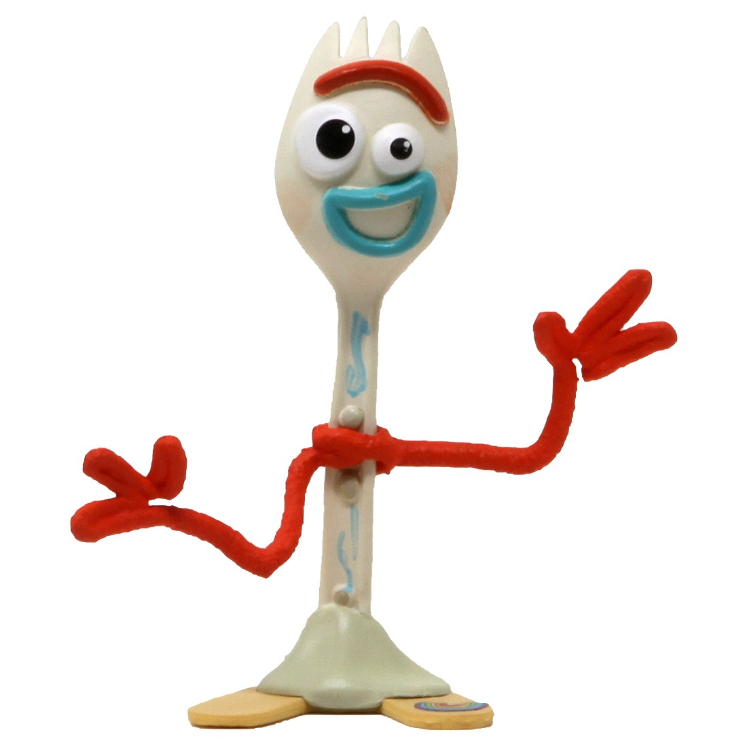
GVZ 2023 Lecture 2
History of Vertebrate Systematics
Species
Species discovery
Species description
Summary and reading week1

Slide 2
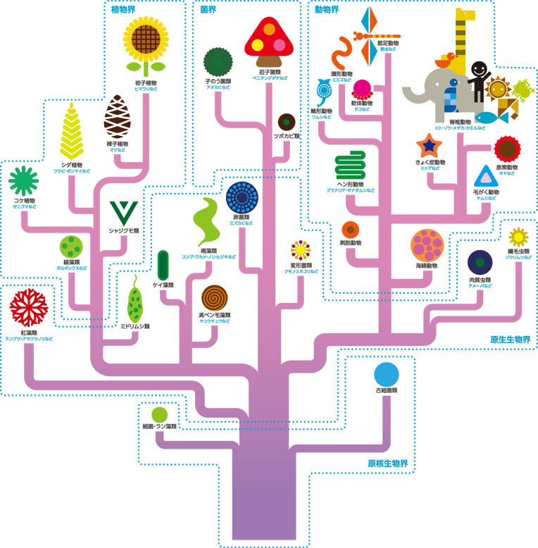
Systematics
Taxonomy
Classification
Nomenclature
Phylogenetics

Slide 3
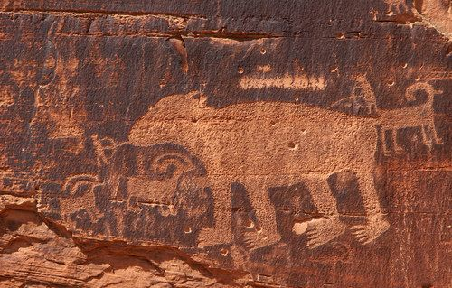
History of (Vertebrate) Systematics
Three periods
BC to 1859
1859-1960s
1960s-now

Slide 4
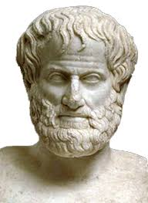
BC to 1859
Aristotle (384-322 BC)
Natural Theology
Classification system
Typology
Scale of Nature
Traits delimit groups

Slide 5
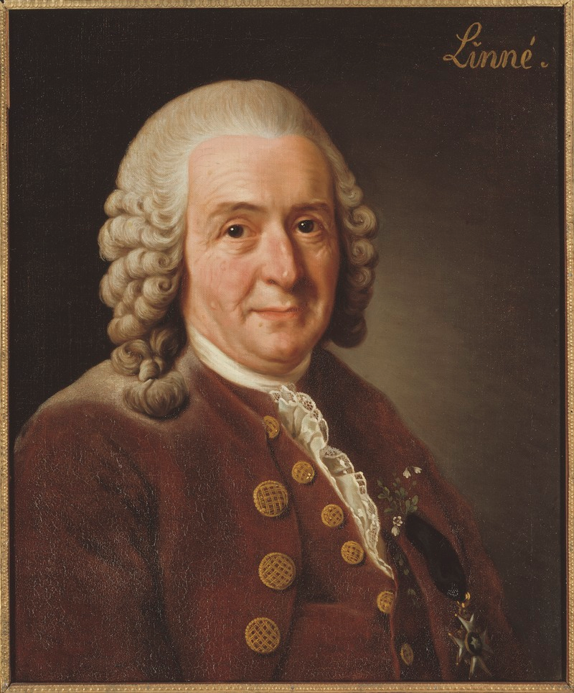
BC to 1859
Aristotle (384-322 BC)
Natural Theology
Classification system
Typology
Scale of Nature
Carl Linnaeus (1707-1778)
Systema Naturae
Standardized Taxonomy
Genus + species
Kingdom, Phylum...

Slide 6
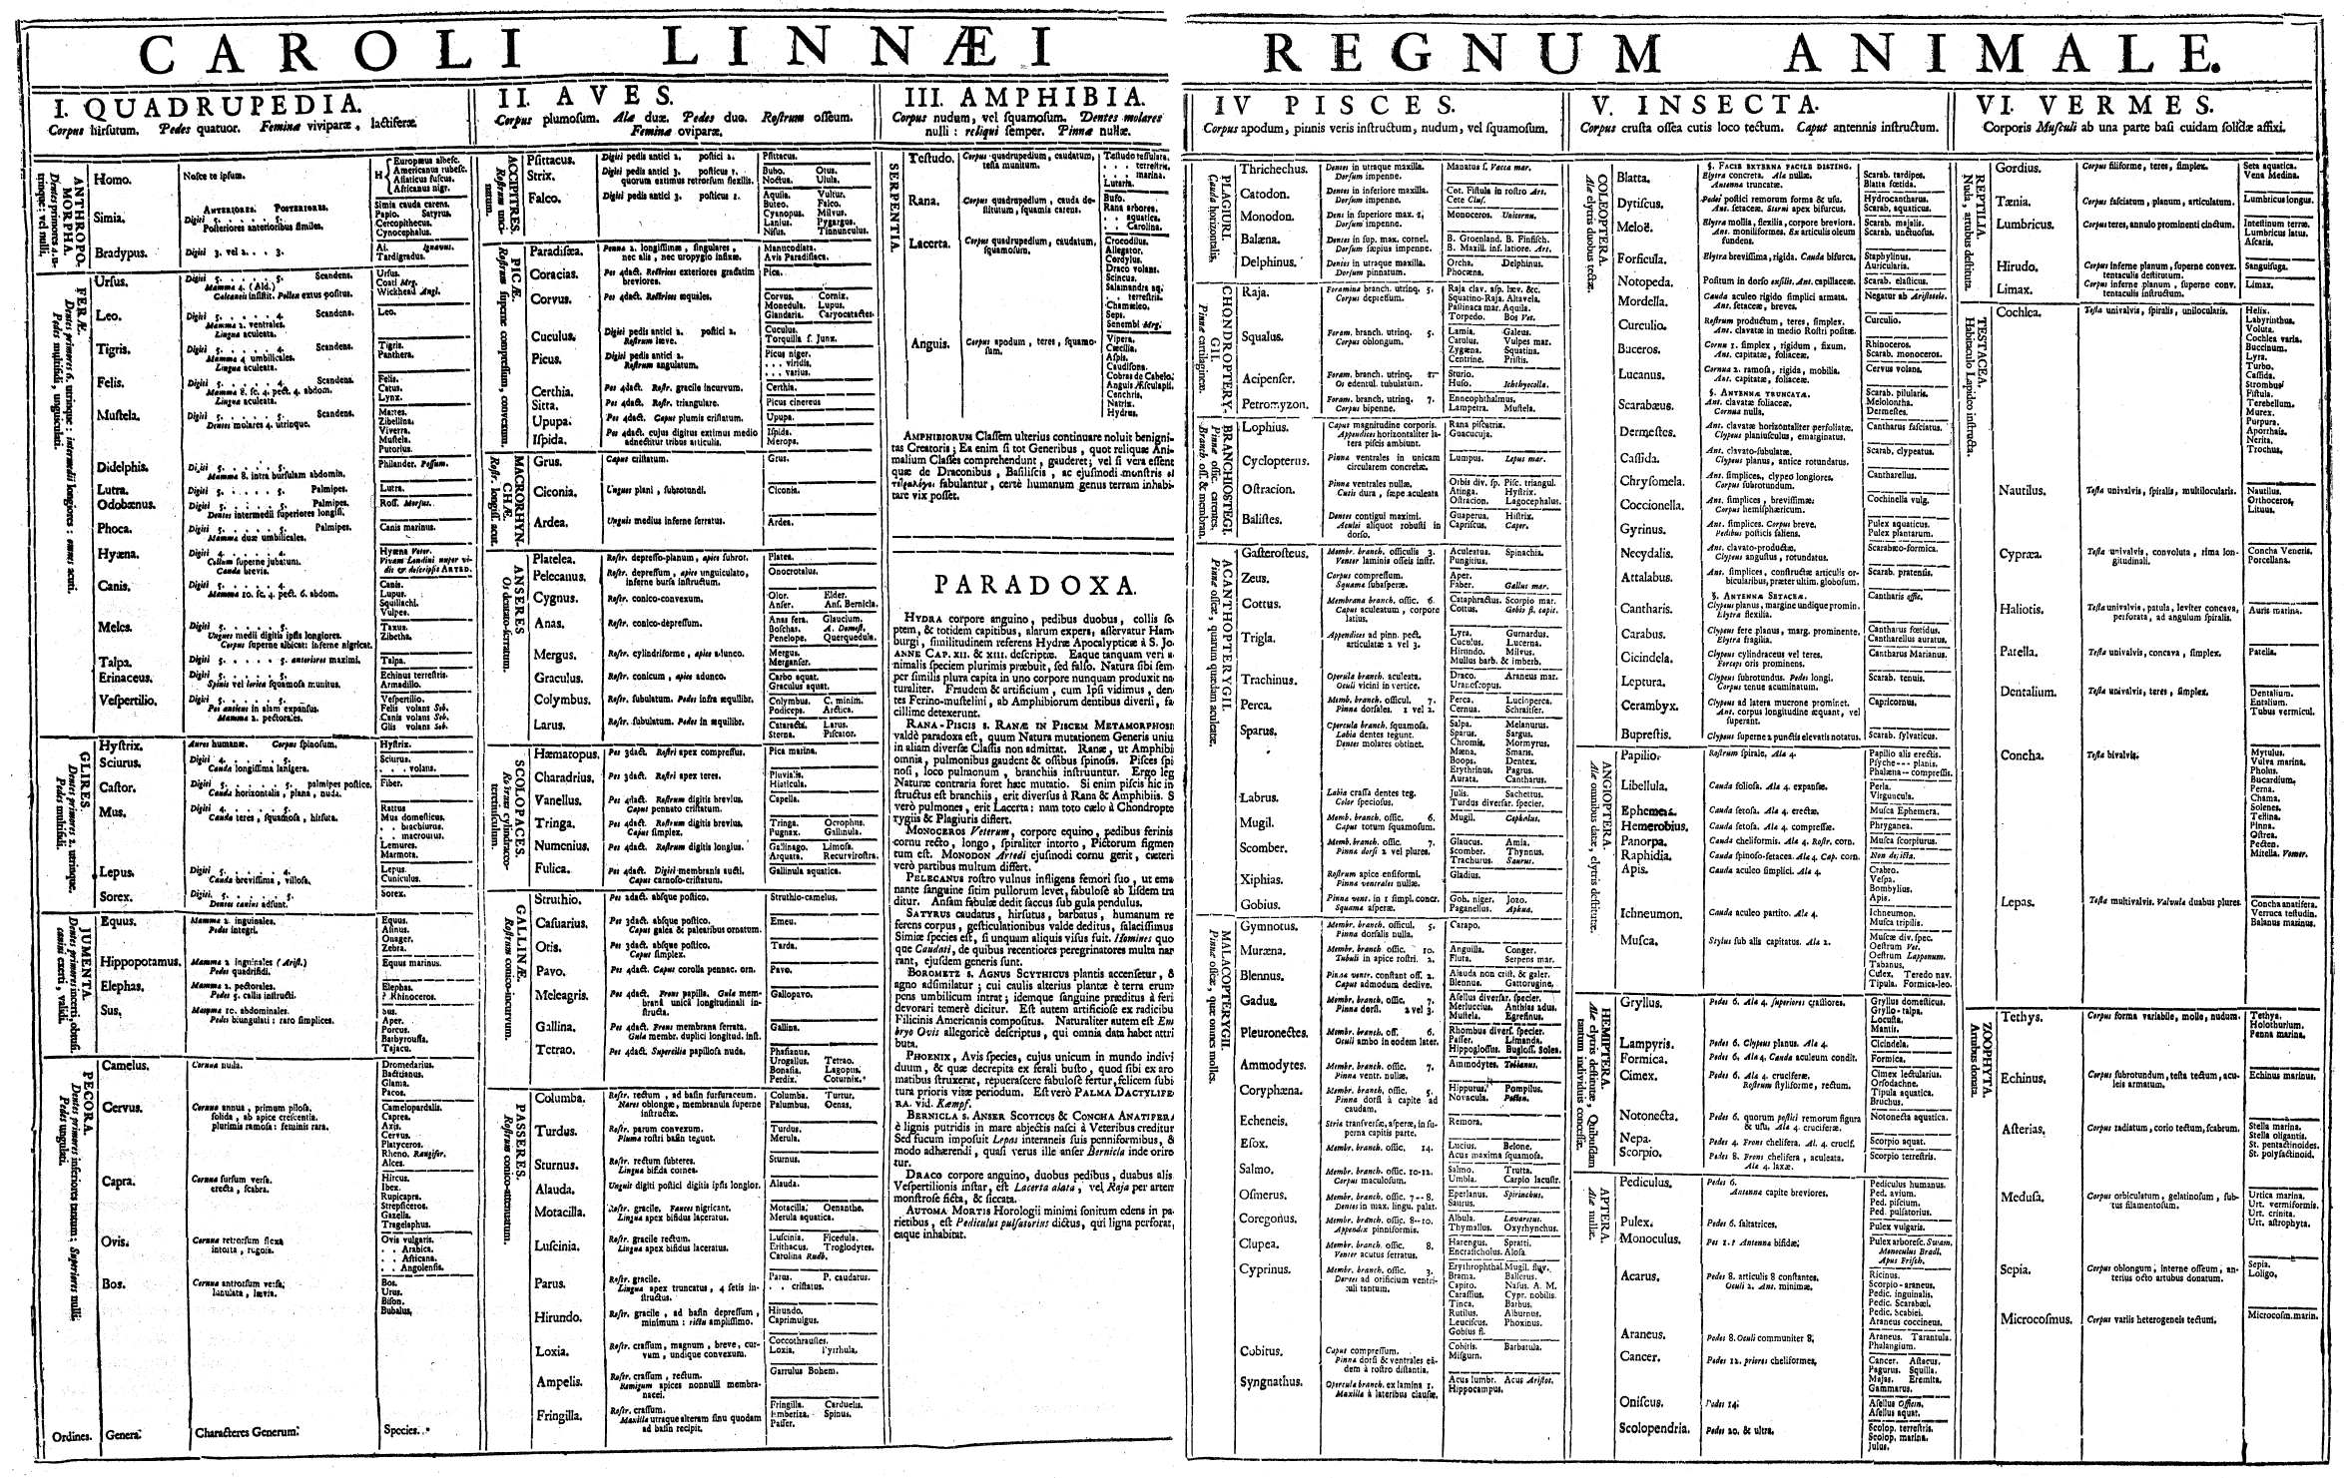

Slide 7
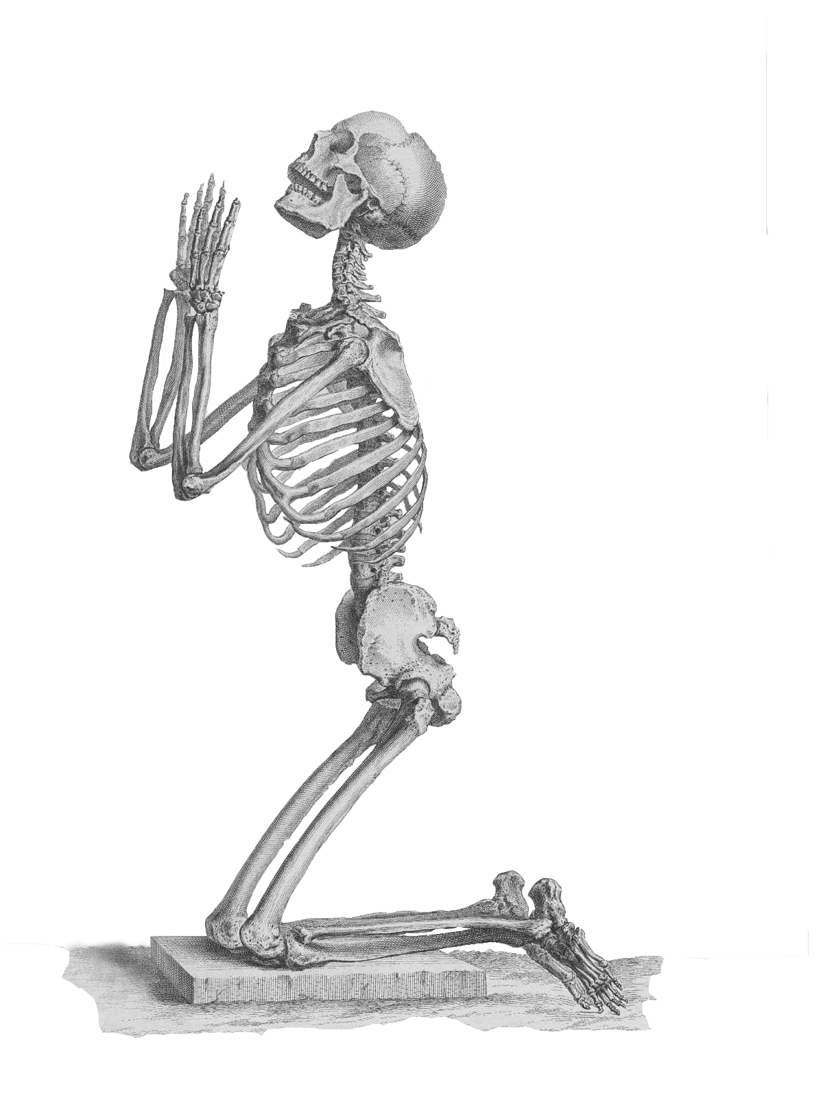
BC to 1859: Prevailing views
No phylogeny (no evolution)
Natural theology
Linnaeus' system
Taxonomy based on traits

Slide 8
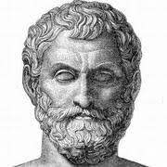
BC to 1859: Prevailing views
No phylogeny (no evolution)
Natural theology
Linnaeus' system
Taxonomy based on traits
BC to 1859: Exceptions
Georges-Louis Leclerc, Comte de Buffon (1707-1788)
Erasmus Darwin (1731-1802)
JB Lamarck (1744-1829)

Slide 9
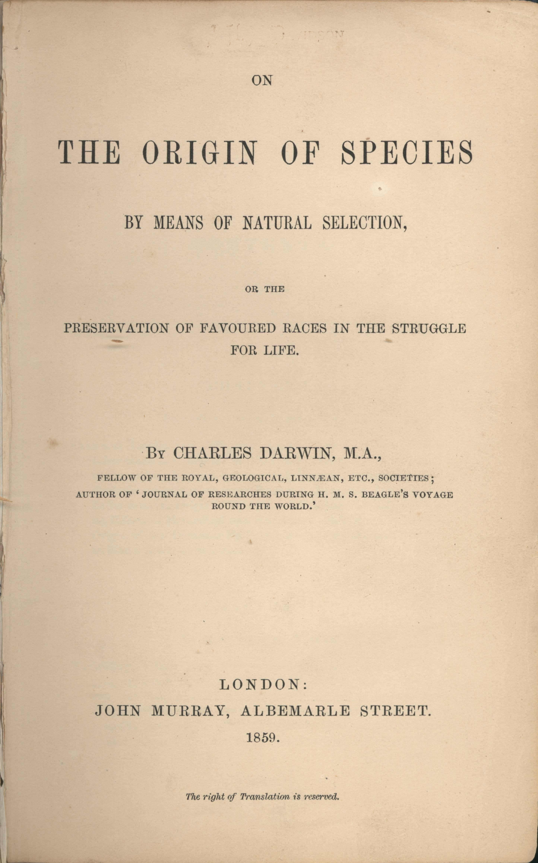
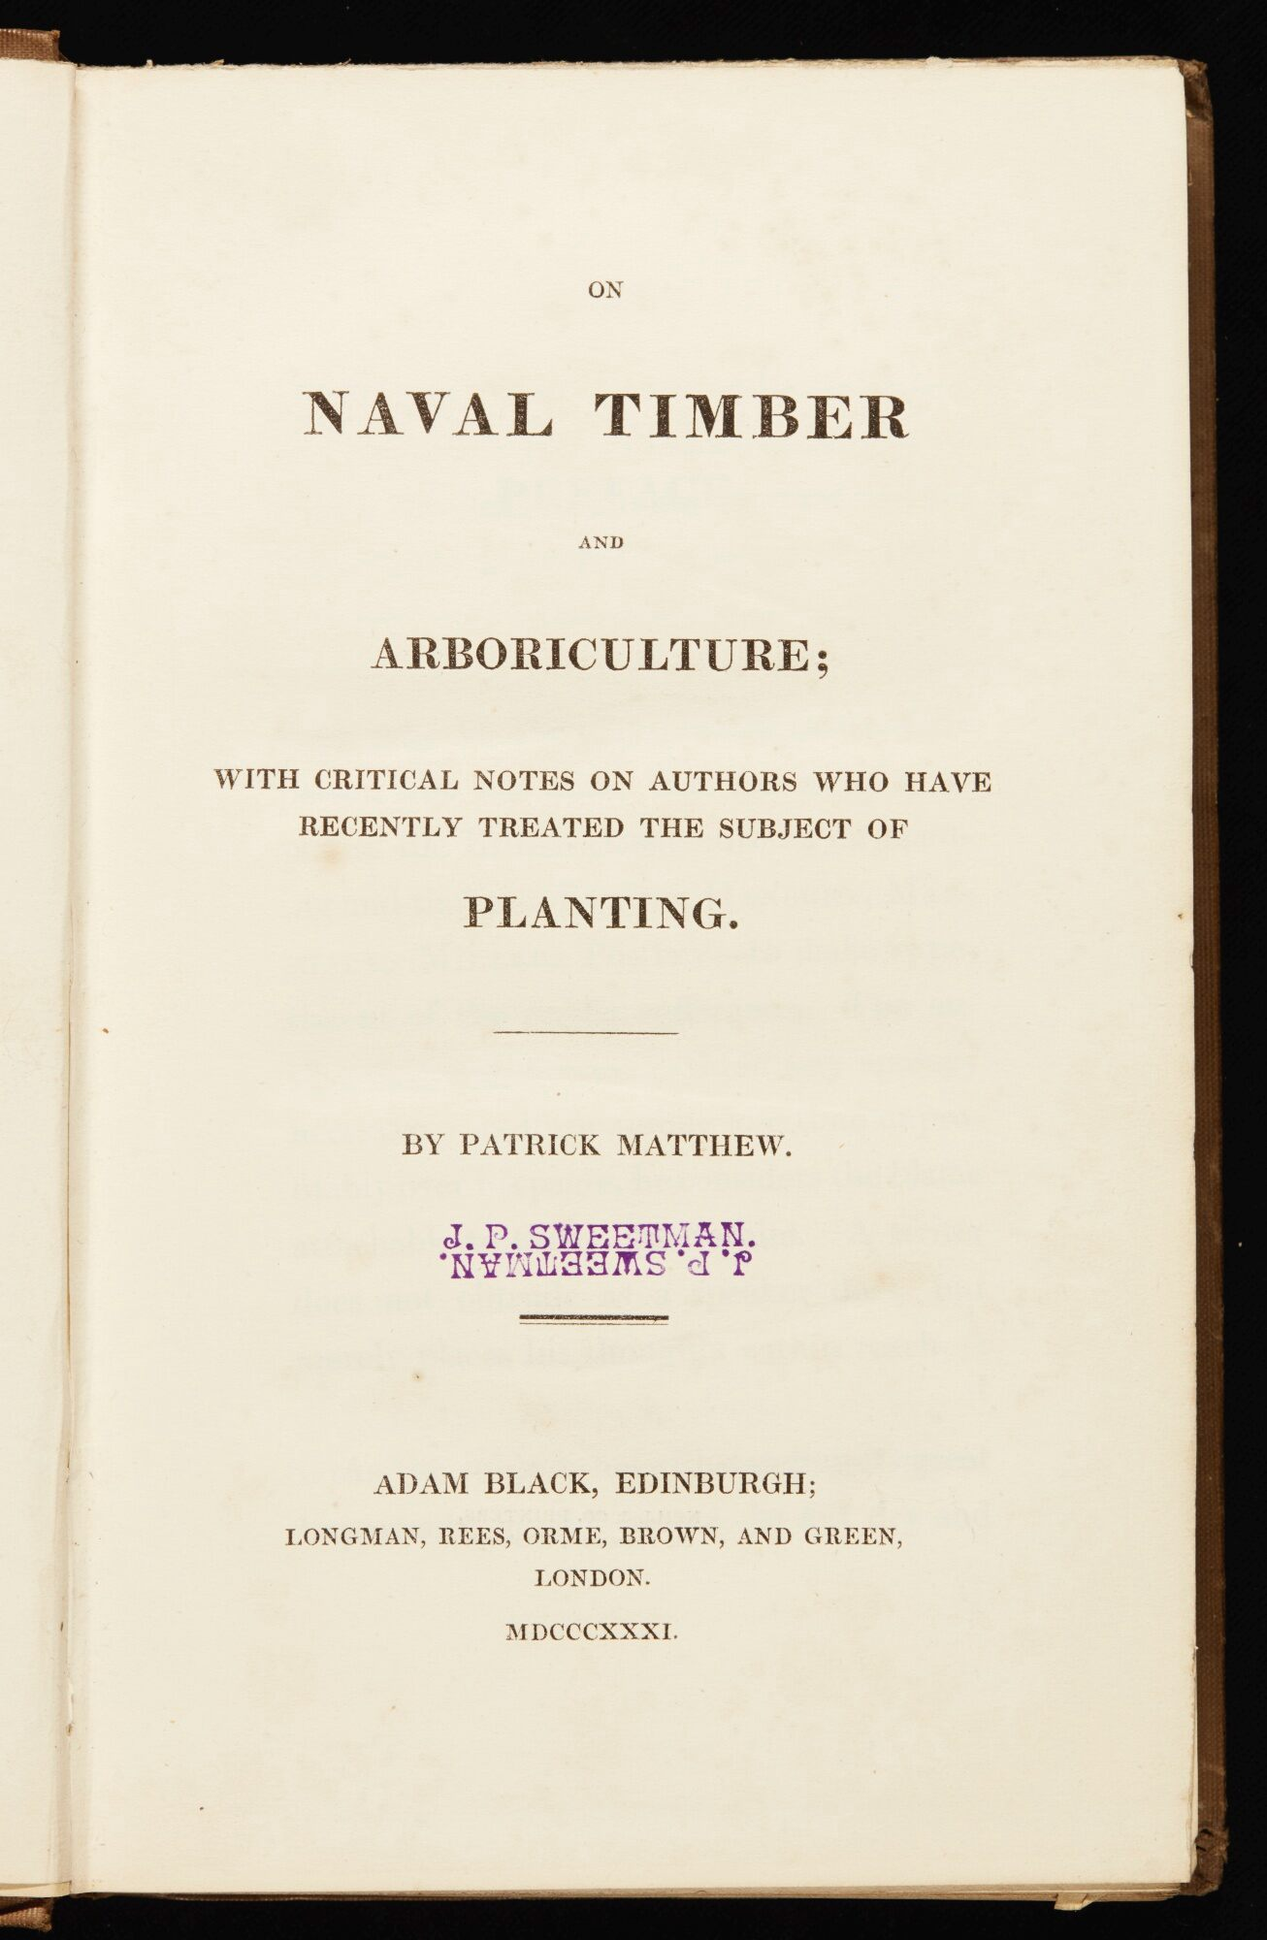
1859-1960s
Evolution (1859)
Darwin, Wallace, Huxley, Matthew
Modern Synthesis (1930s-1940s)
Inheritance + Natural Selection
Mayr, Fisher, Wright, Dobzhansky, Simpson

Slide 10
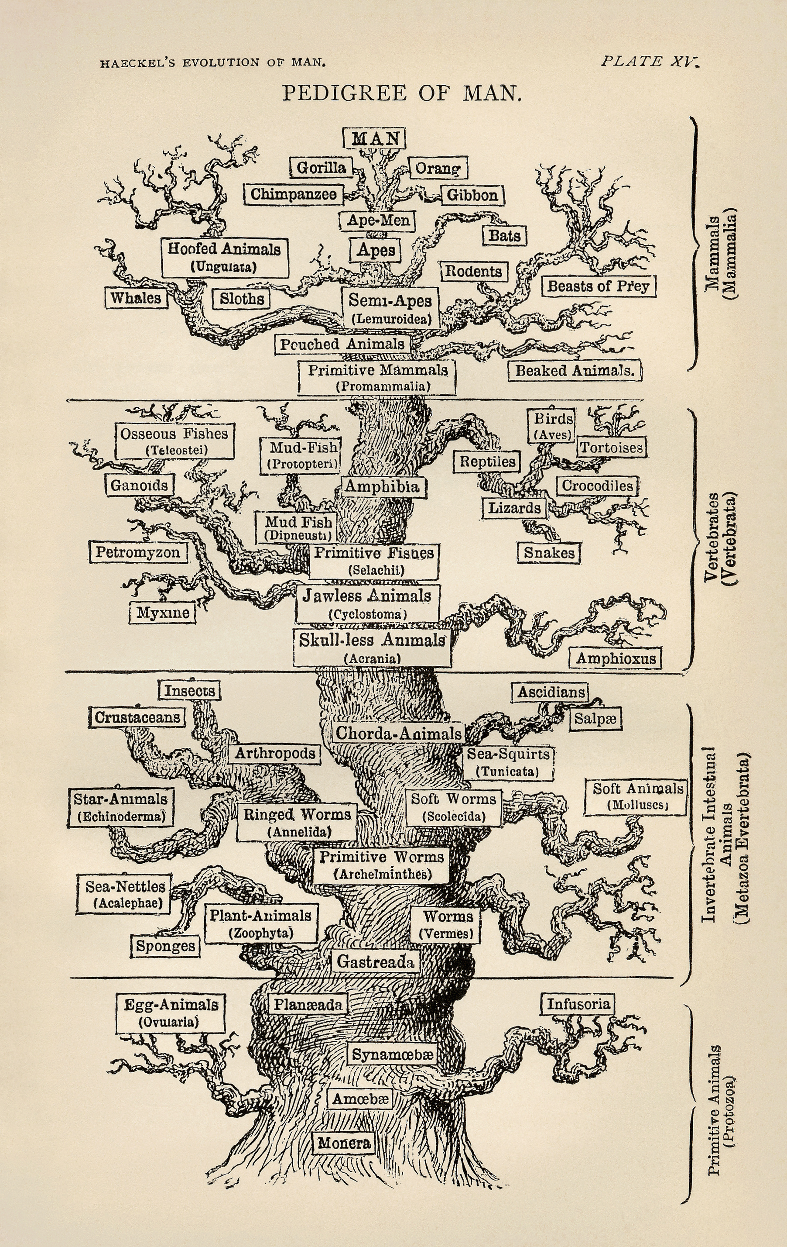
1859-1960s: Prevailing views
Evolution (phylogeny) accepted
Phylogeny reconstruction... …not so much
Taxonomy and phylogeny separate

Slide 11
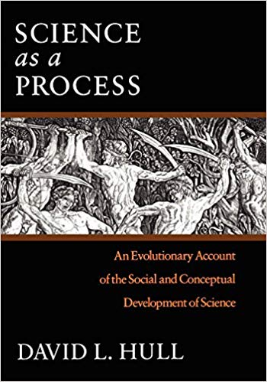
1960s-2000: Classification methods
Evolutionary Taxonomy
Ernst Mayr
Phenetics
R Sokal, P Sneath
Cladistics
W Hennig, JS Farris, EO Wiley
Molecular biologists
A Edwards, L Cavalli-Sforza

Slide 12
1960s-2000: Nomenclature
de Queiroz and Gauthier 1990
Linnaen system is not suitable for describing phylogeny
Define taxon names based on relationship
Rules for constructing names

Slide 13
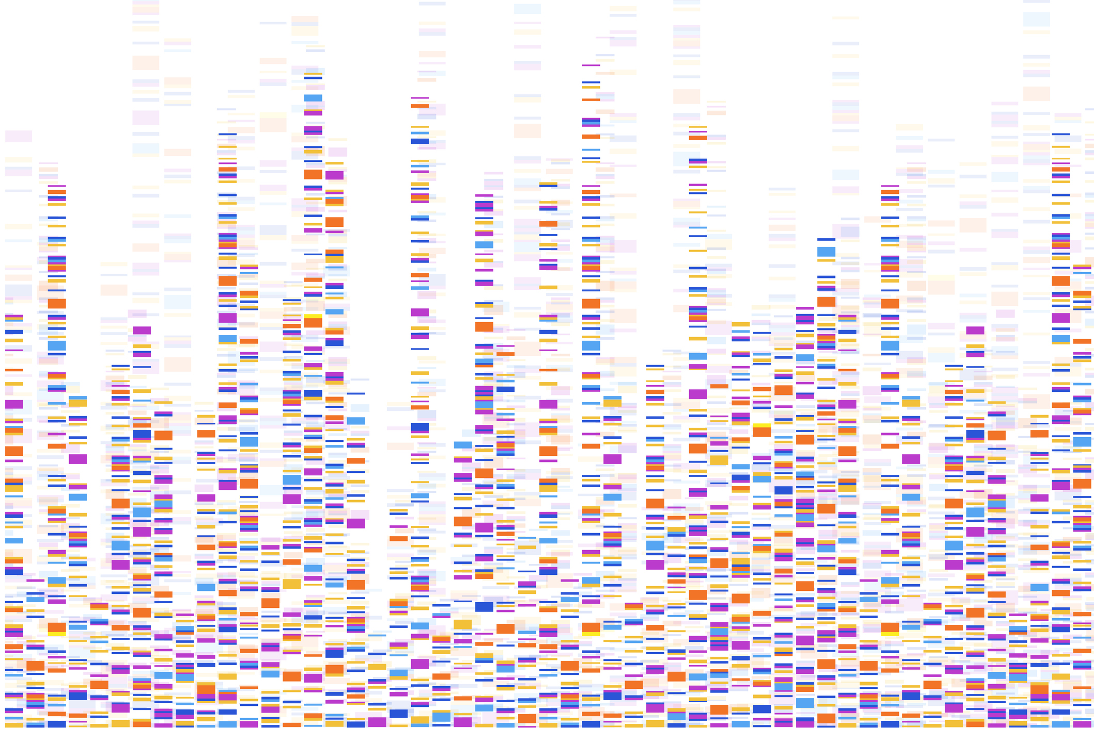
Today
Development of quantitative phylogenetic methods
New sources of genomic data
Phylogenetic nomenclature (mostly) accepted

Slide 14
GVZ 2023 Lecture 2
History of Vertebrate Systematics
Species
Species discovery
Species description
Summary and reading week1

Slide 15
Species definitions

Slide 16
Species definitions
Phenetic species concept: A species is a set of organisms that are similar to each other and distinct from other sets (Sokal and Crovello 1970).

Slide 17
Species definitions
Phenetic species concept: A species is a set of organisms that are similar to each other and distinct from other sets (Sokal and Crovello 1970).
Ecological species concept: A species is a set of organisms exploiting (or adapted to) a single niche (Van Valen 1976).

Slide 18
Species definitions
Phenetic species concept: A species is a set of organisms that are similar to each other and distinct from other sets (Sokal and Crovello 1970).
Ecological species concept: A species is a set of organisms exploiting (or adapted to) a single niche (Van Valen 1976).
Biological species concept: Species are groups of actually or potentially interbreeding natural populations, which are reproductively isolated from other such groups (Mayr 1942).

Slide 19
Species definitions
Phenetic species concept: A species is a set of organisms that are similar to each other and distinct from other sets (Sokal and Crovello 1970).
Ecological species concept: A species is a set of organisms exploiting (or adapted to) a single niche (Van Valen 1976).
Biological species concept: Species are groups of actually or potentially interbreeding natural populations, which are reproductively isolated from other such groups (Mayr 1942).
Phylogenetic species concept: A species is the smallest diagnosable cluster of individual organisms within which there is a parental pattern of ancestry and descent (Cracraft 1983).

Slide 20
Species definitions
Phenetic species concept: A species is a set of organisms that are similar to each other and distinct from other sets (Sokal and Crovello 1970).
Ecological species concept: A species is a set of organisms exploiting (or adapted to) a single niche (Van Valen 1976).
Biological species concept: Species are groups of actually or potentially interbreeding natural populations, which are reproductively isolated from other such groups (Mayr 1942).
Phylogenetic species concept: A species is the smallest diagnosable cluster of individual organisms within which there is a parental pattern of ancestry and descent (Cracraft 1983).
Evolutionary species concept: A species is a single lineage of ancestor-descendant populations which maintain its identity from other such lineages and which has its own evolutionary tendencies and historical fate (Wiley 1981).

Slide 25
Species (Frost and Kluge 1994; deQueiroz 1998)
Species concept: What is a species?
Species criterion: How can we tell whether two groups of individuals are separate species?

Slide 26
Species (Frost and Kluge 1994; de Queiroz 1998)
Species concept: What is a species?
an evolutionary lineage (ancestors => descendants) of populations (=Evolutionary Species Concept)
Species criterion: How can we tell whether two groups of individuals are separate species?

Slide 27
Species (Frost and Kluge 1994; de Queiroz 1998)
Species concept: What is a species?
an evolutionary lineage (ancestors => descendants) of populations (=Evolutionary Species Concept)
Species criterion: How can we tell whether two groups of individuals are separate species?
Can they interbreed? (Biological Species Concept)
Do they occupy different niches? (Ecological Species Concept)
Does some trait(s) differentiate them (Phenetic Species Concept)
Does a phylogenetic analysis indicate they are distinguishable by synapomorphies? (Phylogenetic Species Concept)

Slide 28
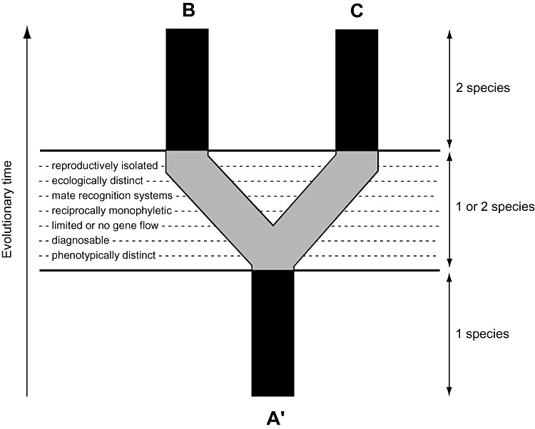

Slide 29
Species concepts: History
Pre-1942
Essentialism
Key reading: Aristotle

Slide 30
Species concepts: History
Pre-1942
Essentialism
Key reading: Aristotle
1940s-1990s
Interbreeding; "population thinking"
Lots of philosophical work (Hull, Ghiselin, Hey)
Key reading: Mayr 1942. Systematics and the origin of species from the viewpoint of a zoologist.

Slide 31
Species concepts: History
Pre-1942
Essentialism
Key reading: Aristotle
1940s-1990s
Interbreeding; "population thinking"
Lots of philosophical work (Hull, Ghiselin, Hey)
Key reading: Mayr 1942. Systematics and the origin of species from the viewpoint of a zoologist.
1990s-now
Species = evolutionary lineages (Simpson, Wiley)
Operational/conceptual distinction
Key reading: Wiley 1981, Frost and Kluge 1994, de Queiroz 1998

Slide 32
Summary/important aspects of species
Species are evolutionarily independent lineages of populations (EVSC)
Most species "concepts" (BSC, PHYSC, ECSC, PHENSC) capture operational elements of the EVSC
Species are "natural" entities, not human constructs
Subspecies are operational pattern classes
Interbreeding is (very) important, but it is just one aspect of species and speciation

Slide 33
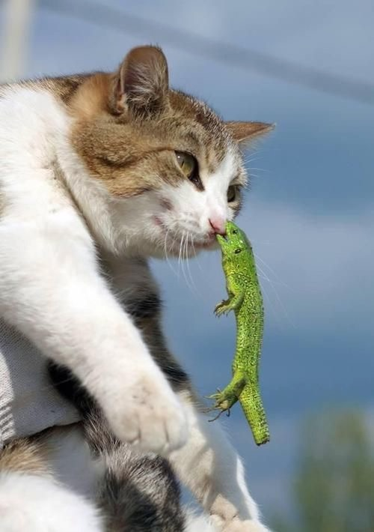

Slide 34
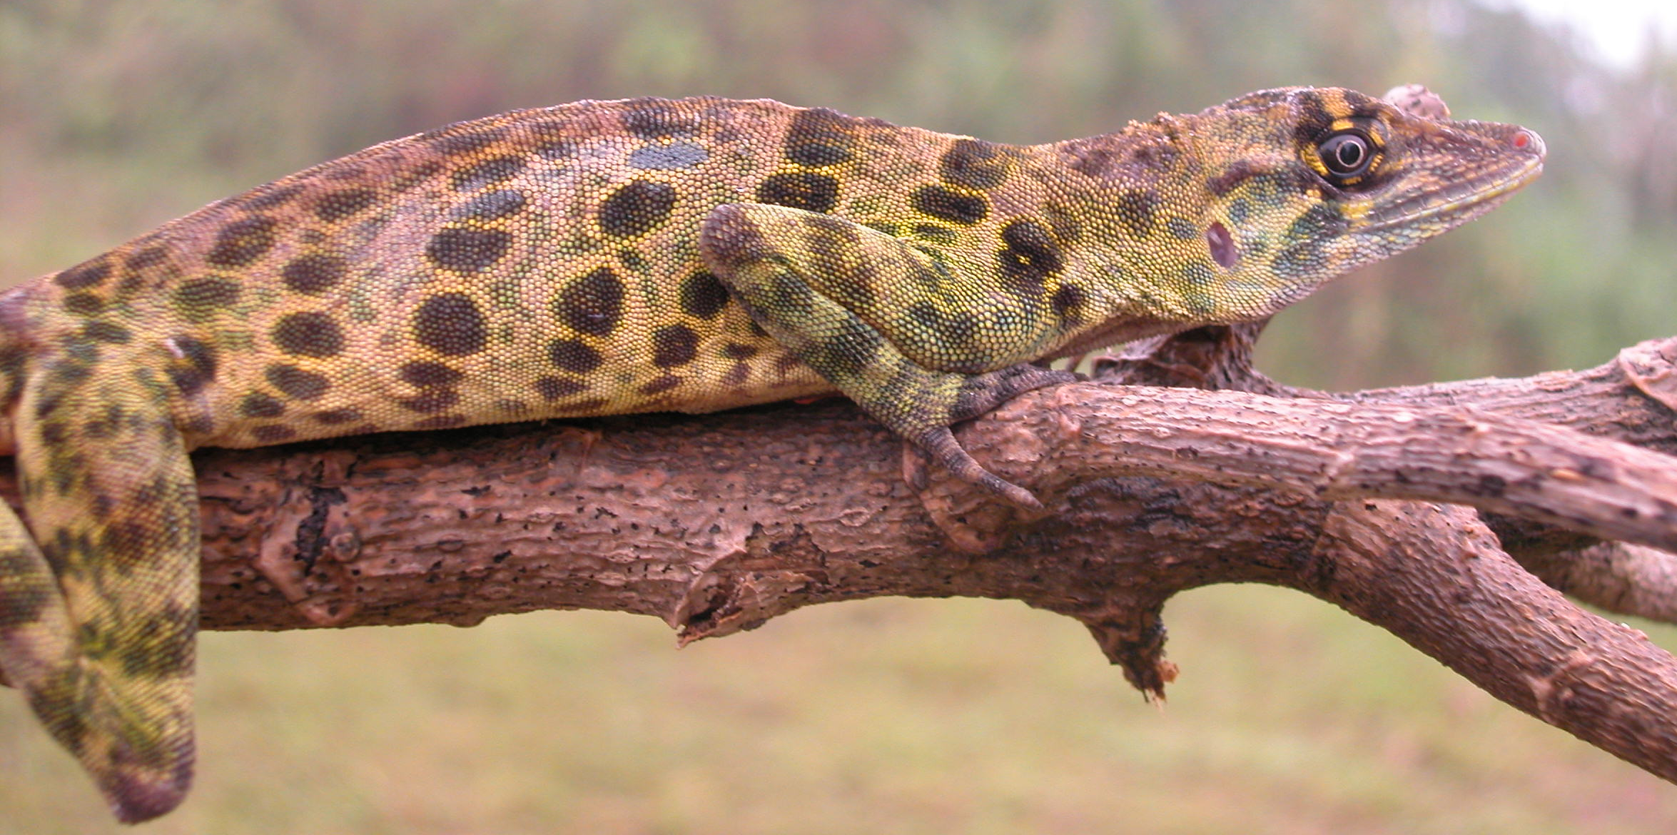
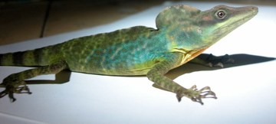
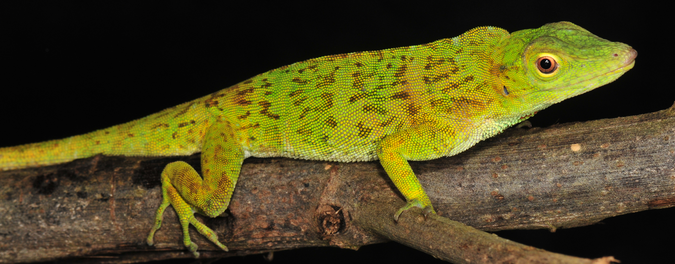
Species discovery
Phenetic
Find an individual or population in nature that appears different from other known populations
Compare individuals of purported new species to individuals of known species; search for diagnostic differences

Slide 35
Species discovery
Phenetic
Find an individual or population in nature that appears different from other known populations
Compare individuals of purported new species to individuals of known species; search for diagnostic differences
Phylogenetic
Obtain DNA sequences for multiple individuals from throughout the range of a species
Perform phylogentic analysis
Recognize separate clades with some degree of genetic divergence as separate species

Slide 36
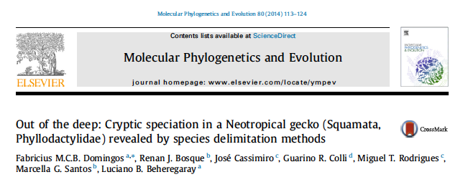
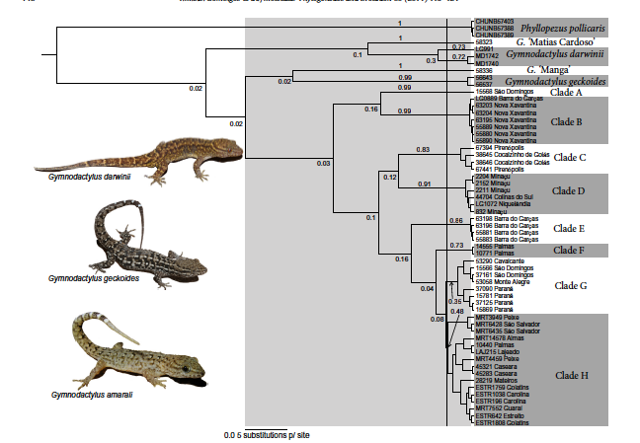
Species discovery

Slide 37
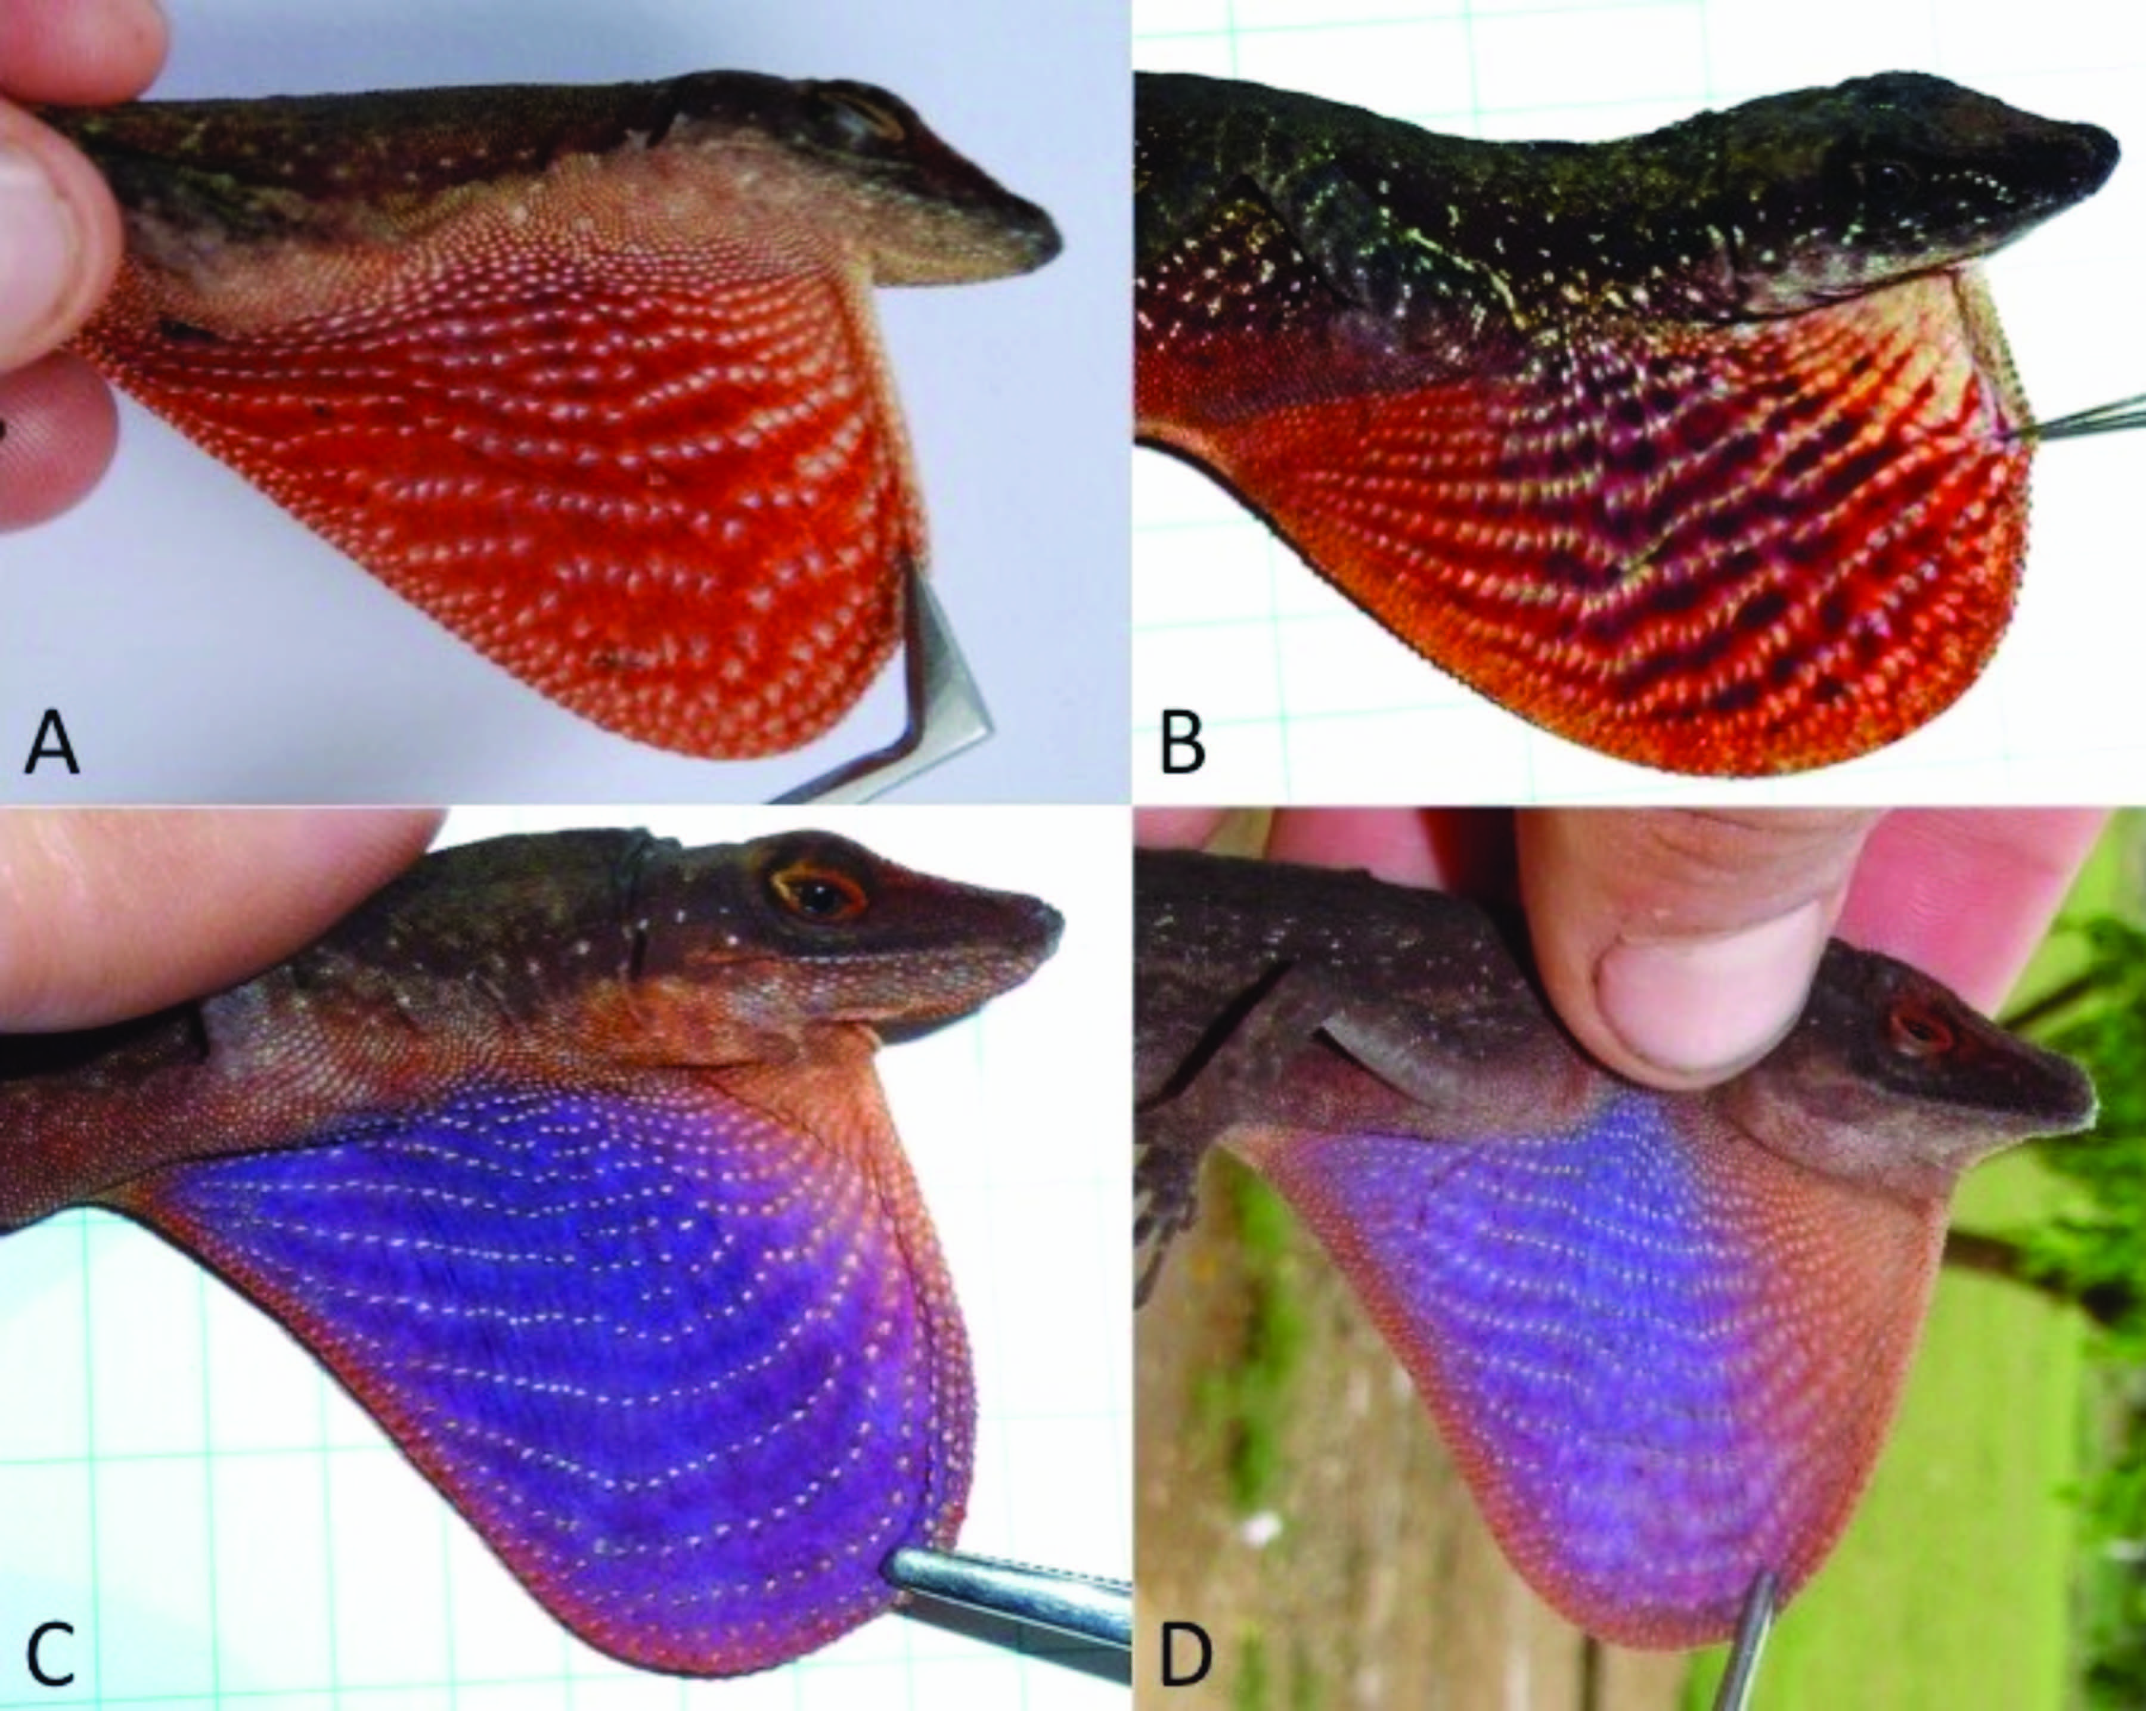
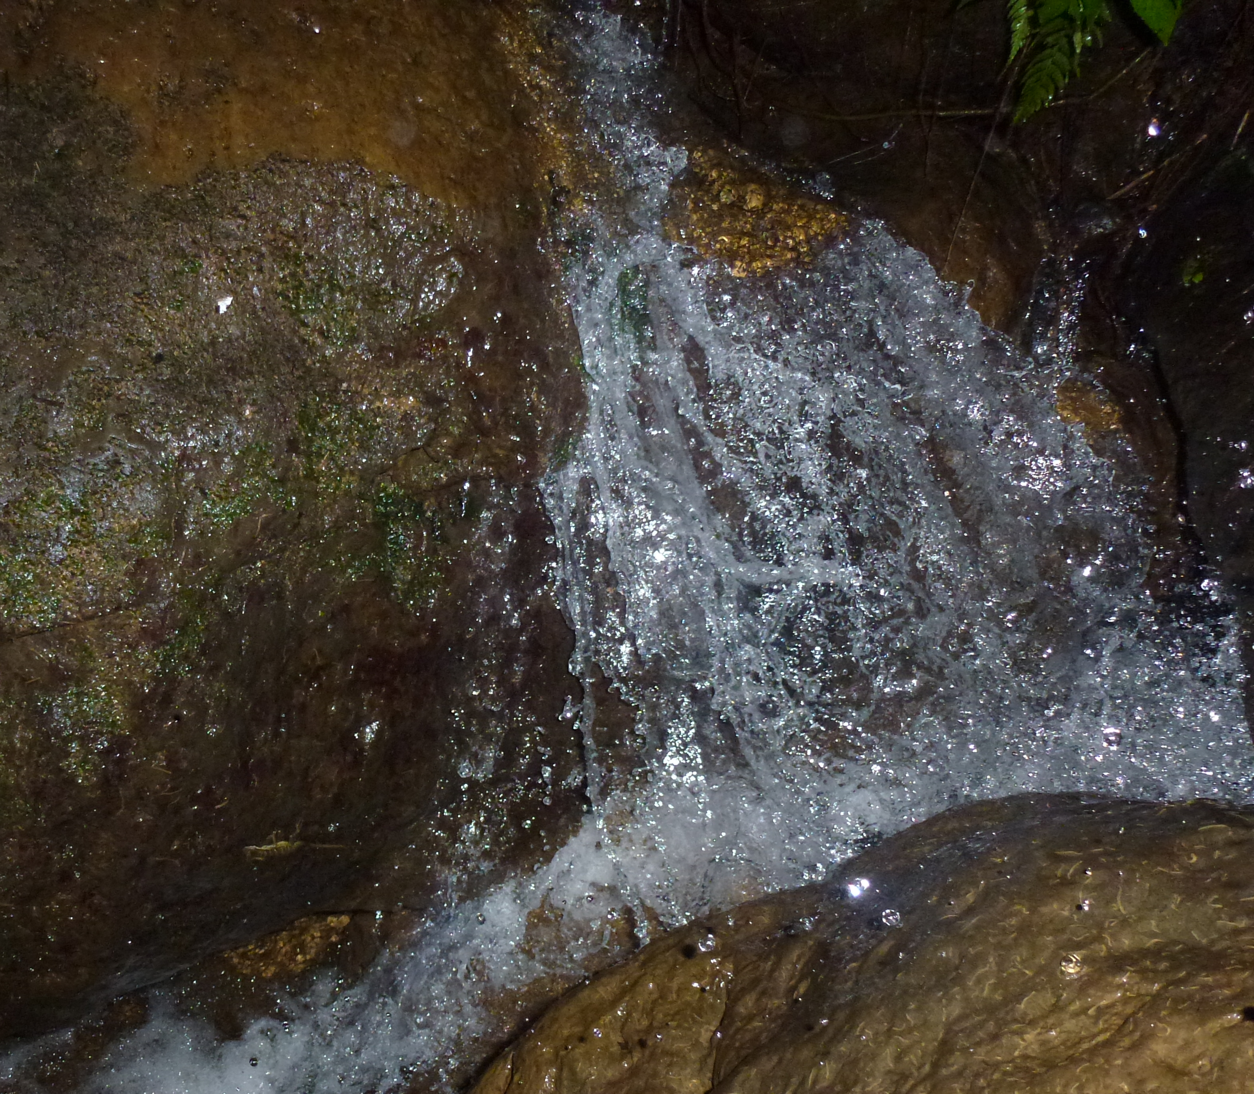
Species description
Name the species
Anolis purpuronectes
Anolis elcopeensis
Anolis taylori
Anolis cochranae
Anolis williamsmittermeierorum

Slide 38
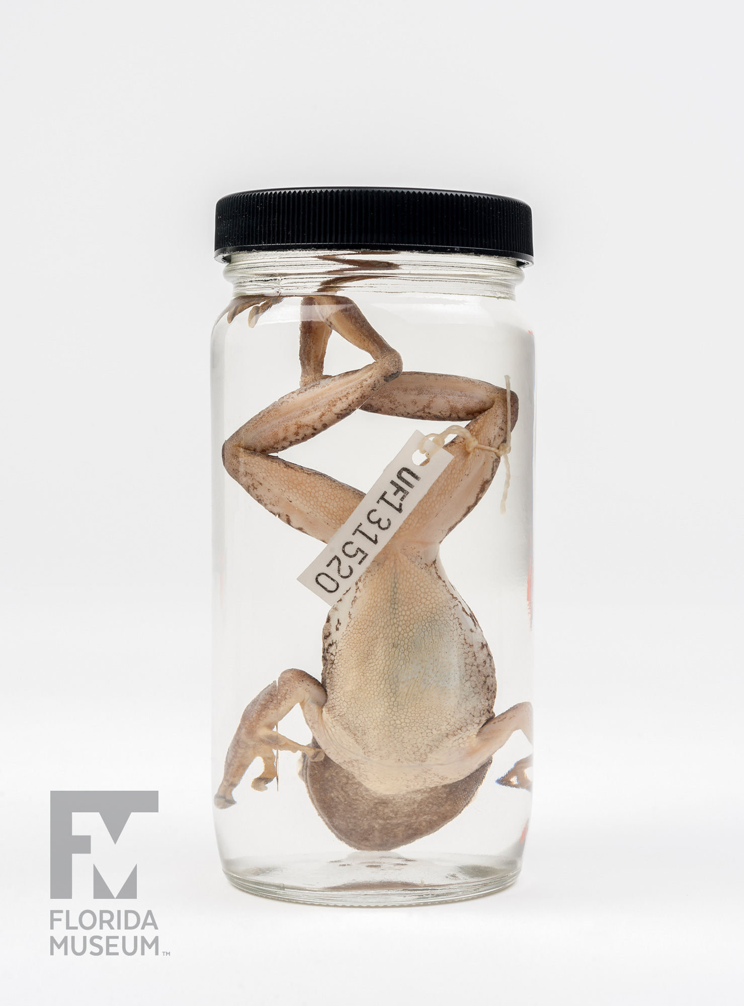
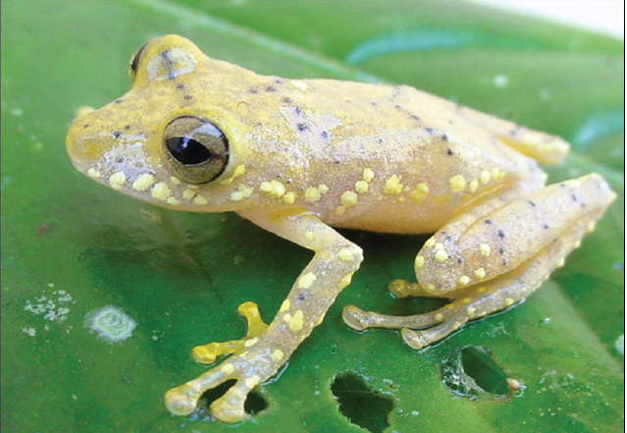
Species description
Name the species
Designate a Holotype
Diagnose the species
Describe the Holotype and variation among paratypes
Other data
illustrations, range map, ecology, phylogeny

Slide 42
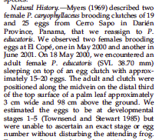
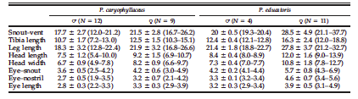

Slide 44
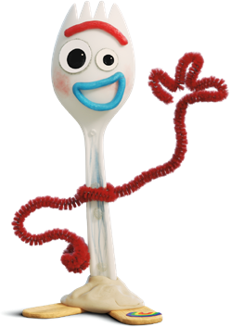
GVZ Week 1
Sources of Information
Nichols Death of Expertise
History of (Vertebrate) Systematics
Species
Concepts
De Queiroz 1998
species definitions we covered
species concept vs species criteria
pp 57-66
General Lineage Concept = Evolutionary Species Concept]
Discovery and description
Ryan et al. 2010, Yañez-Munoz et al. 2018

