Slide 1
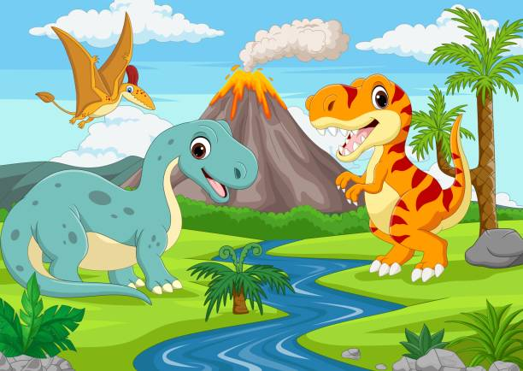
GVZ 2 November 2023
Nonavian dinosaurs
NM dinosaurs
Nondinosaurs

Slide 2
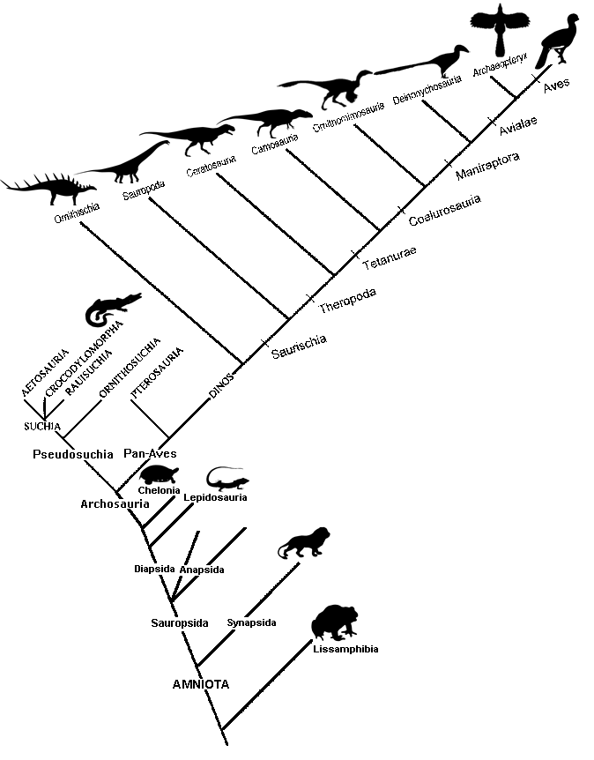
Dinosauria

Slide 3
Synapomorphies of Dinosauria

Slide 4
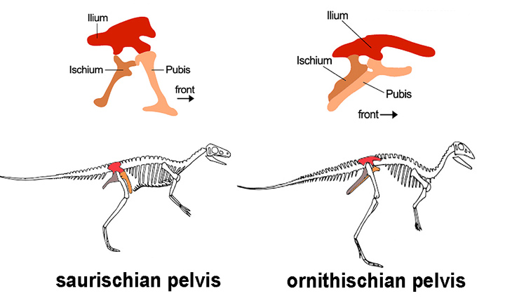

Slide 5
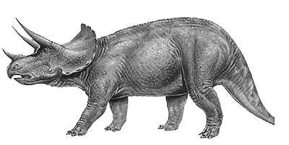
Ornithischians

Slide 6
Ornithischians: Ankylosaurus

Slide 7
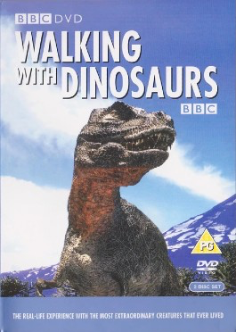
Dinosaur documentaries
Walking with Dinosaurs 1999
BBC, Kenneth Branagh
Planet Dinosaur 2011
BBC, John Hurt
Prehistoric Planet 2022
AppleTV, BBC, David Attenborough, Jon Favreau

Slide 8
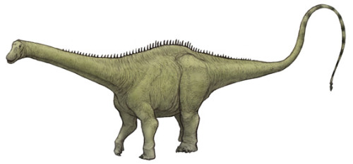
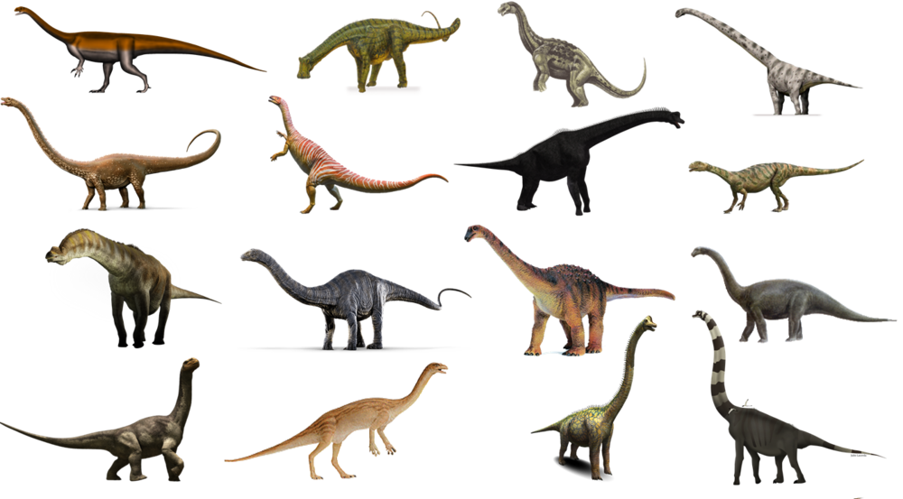
Sauropods

Slide 9
Sauropods: Argentinosaurus

Slide 10
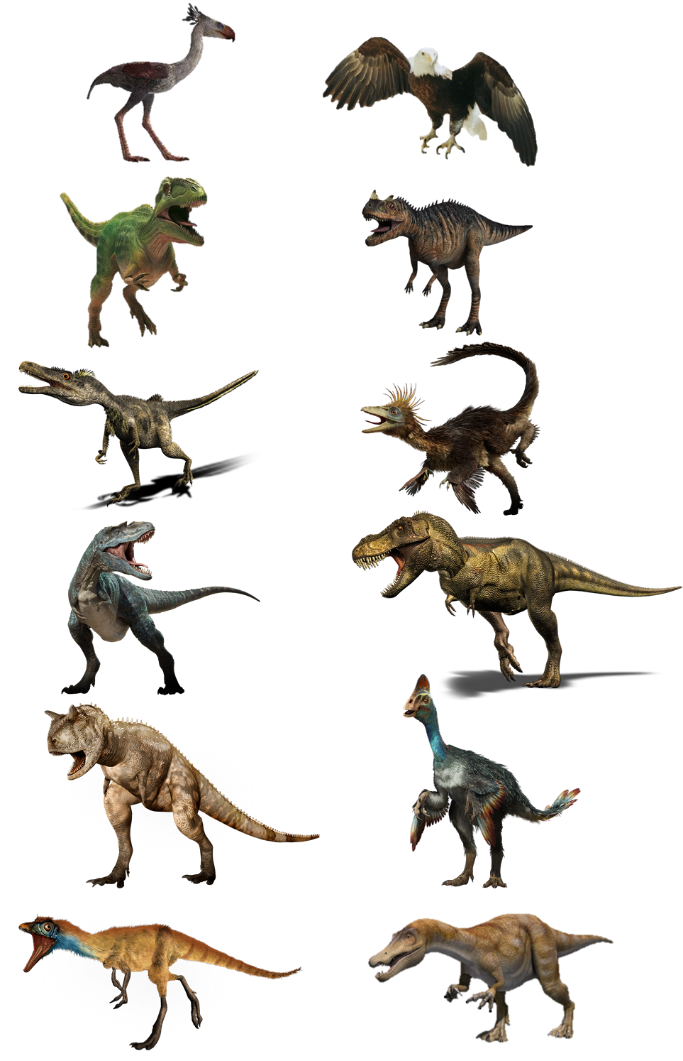
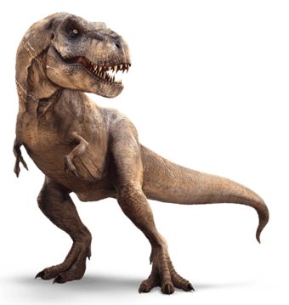
Theropods

Slide 11
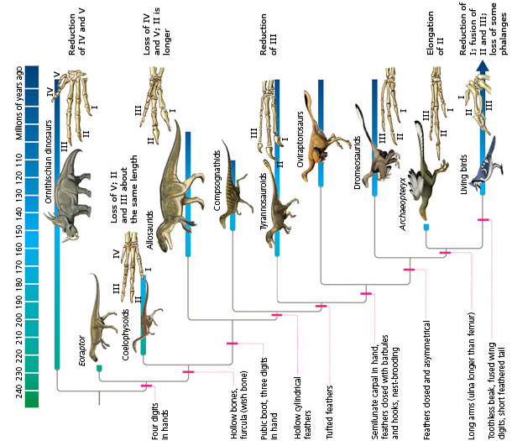
Synapomorphies of Aves (most shared with theropods)

Slide 12
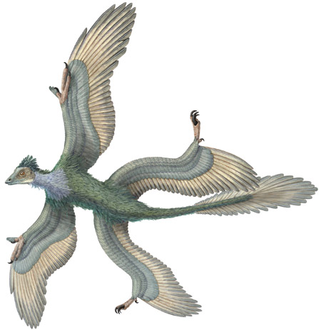

Slide 13
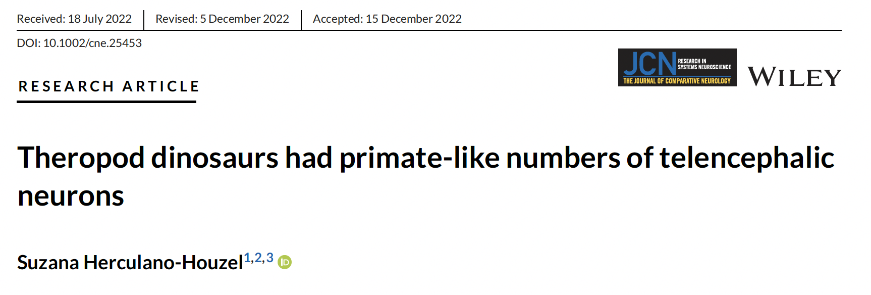
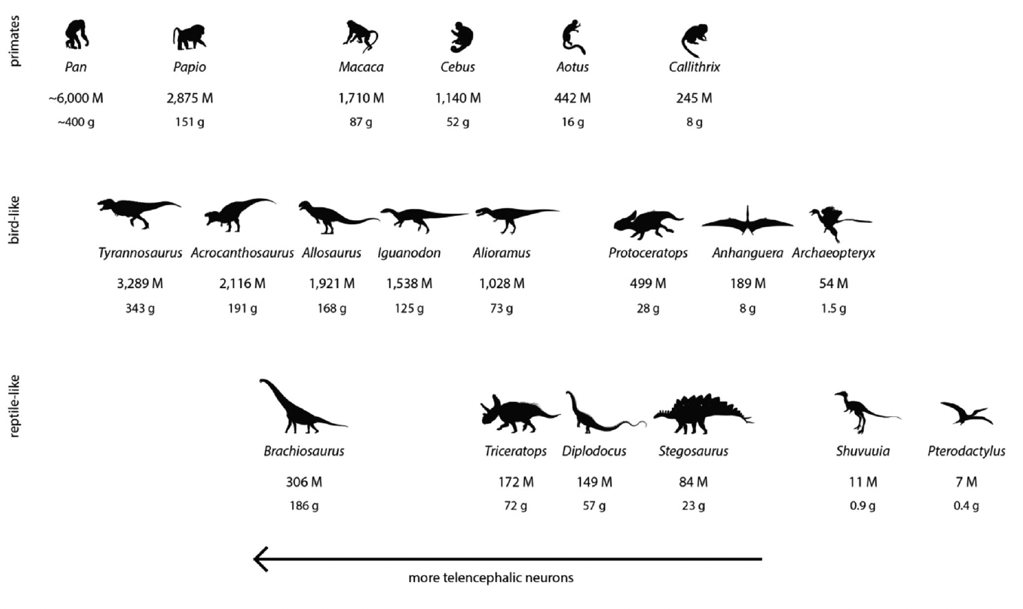
"…theropods such as Tyrannosaurus and Allosaurus were endotherms with baboon- and monkey-like numbers of telencephalic
neurons, respectively, which would make these animals not only giant but also longlived and endowed with flexible cognition, and thus even more magnificent predators than previously thought."

Slide 14
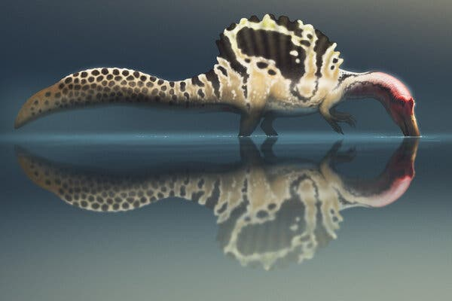
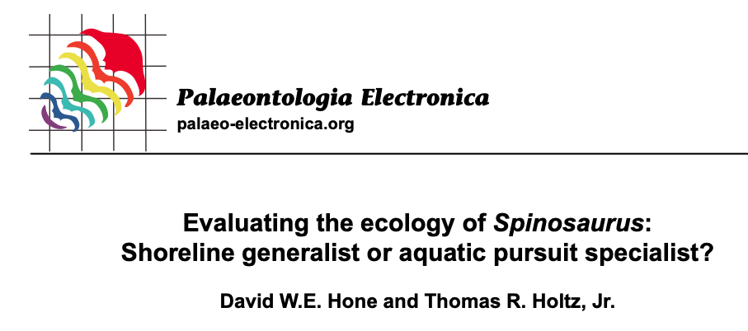
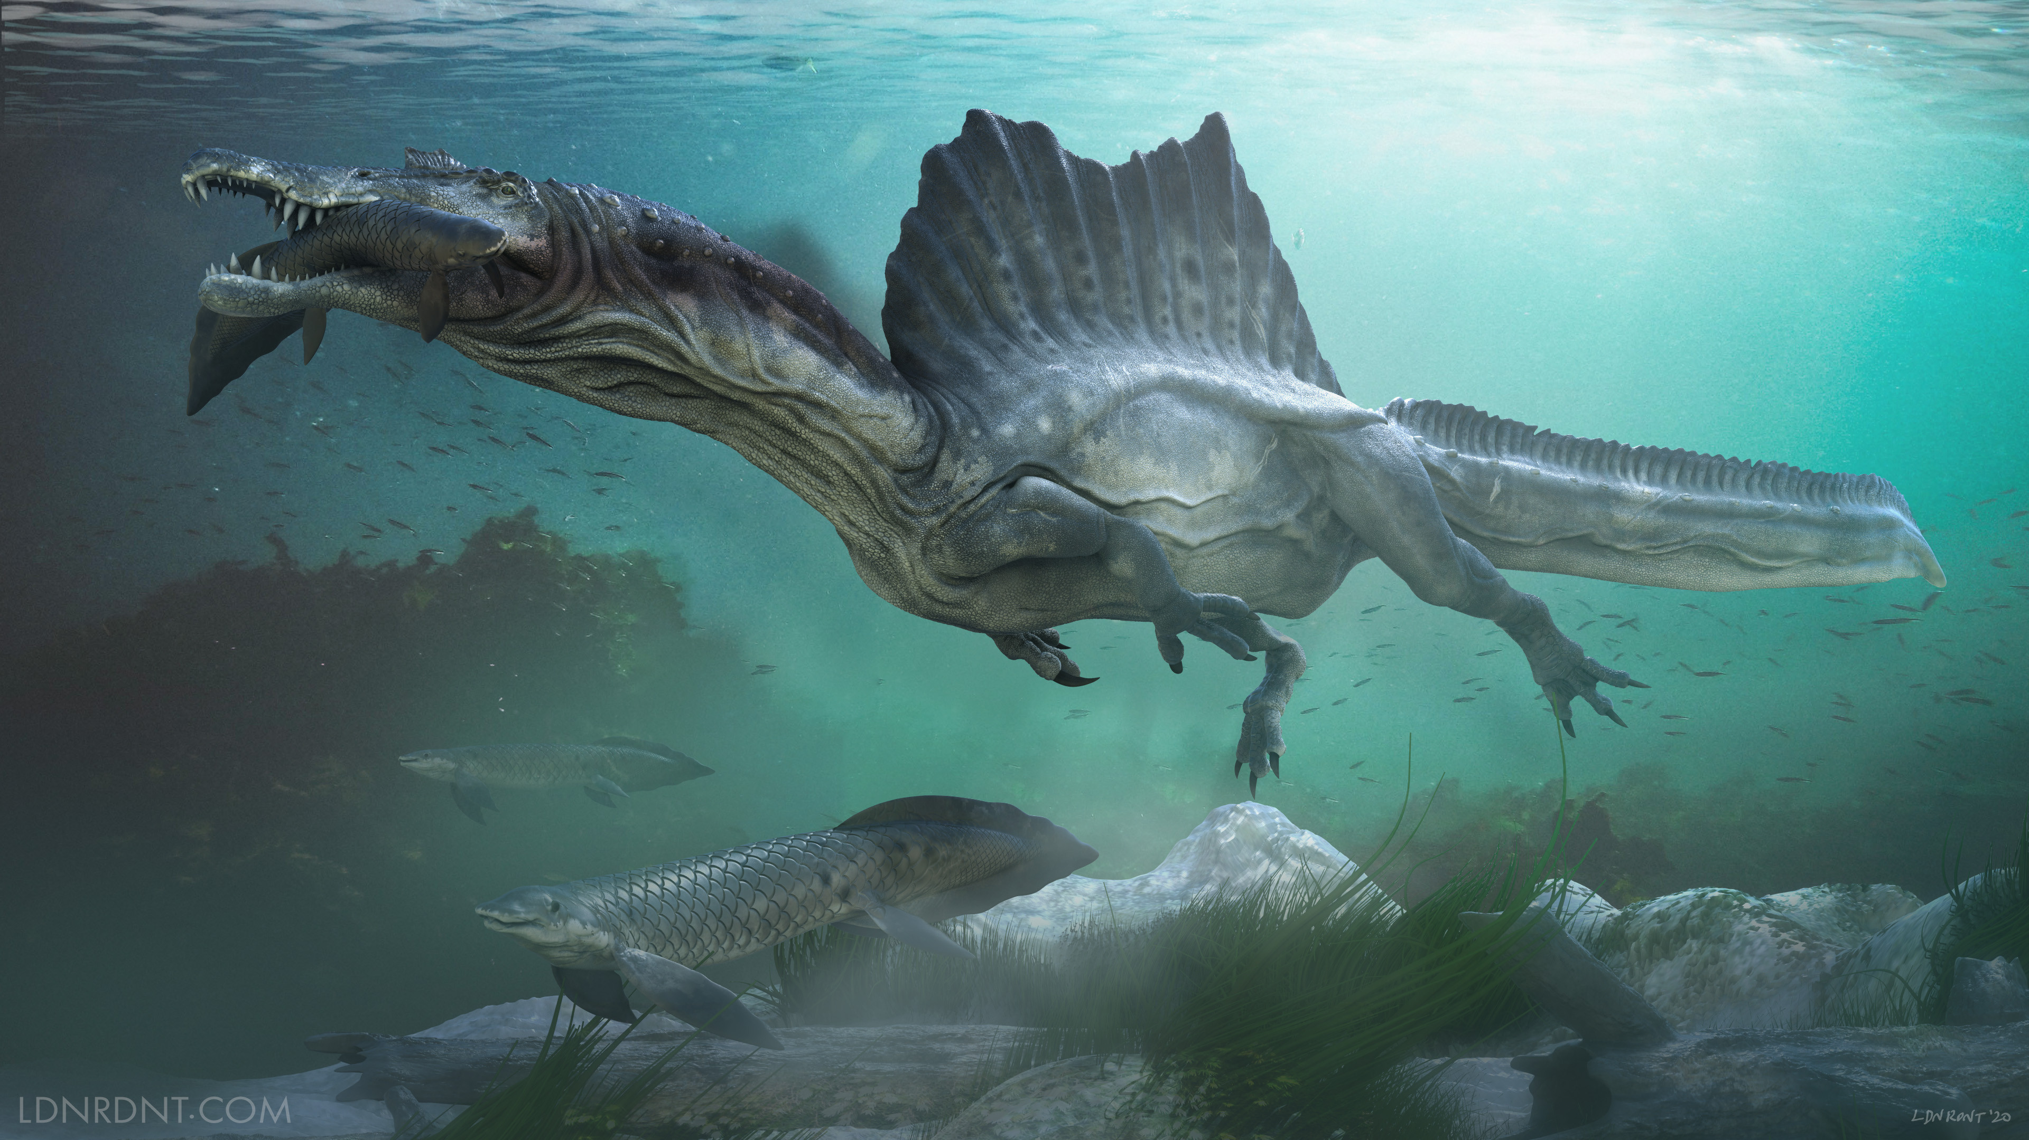
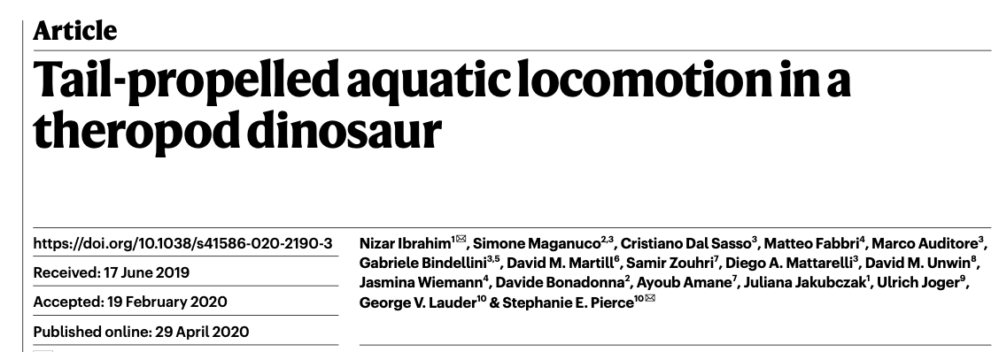
Theropods: Spinosaurus

Slide 15
Theropods: Spinosaurus

Slide 17
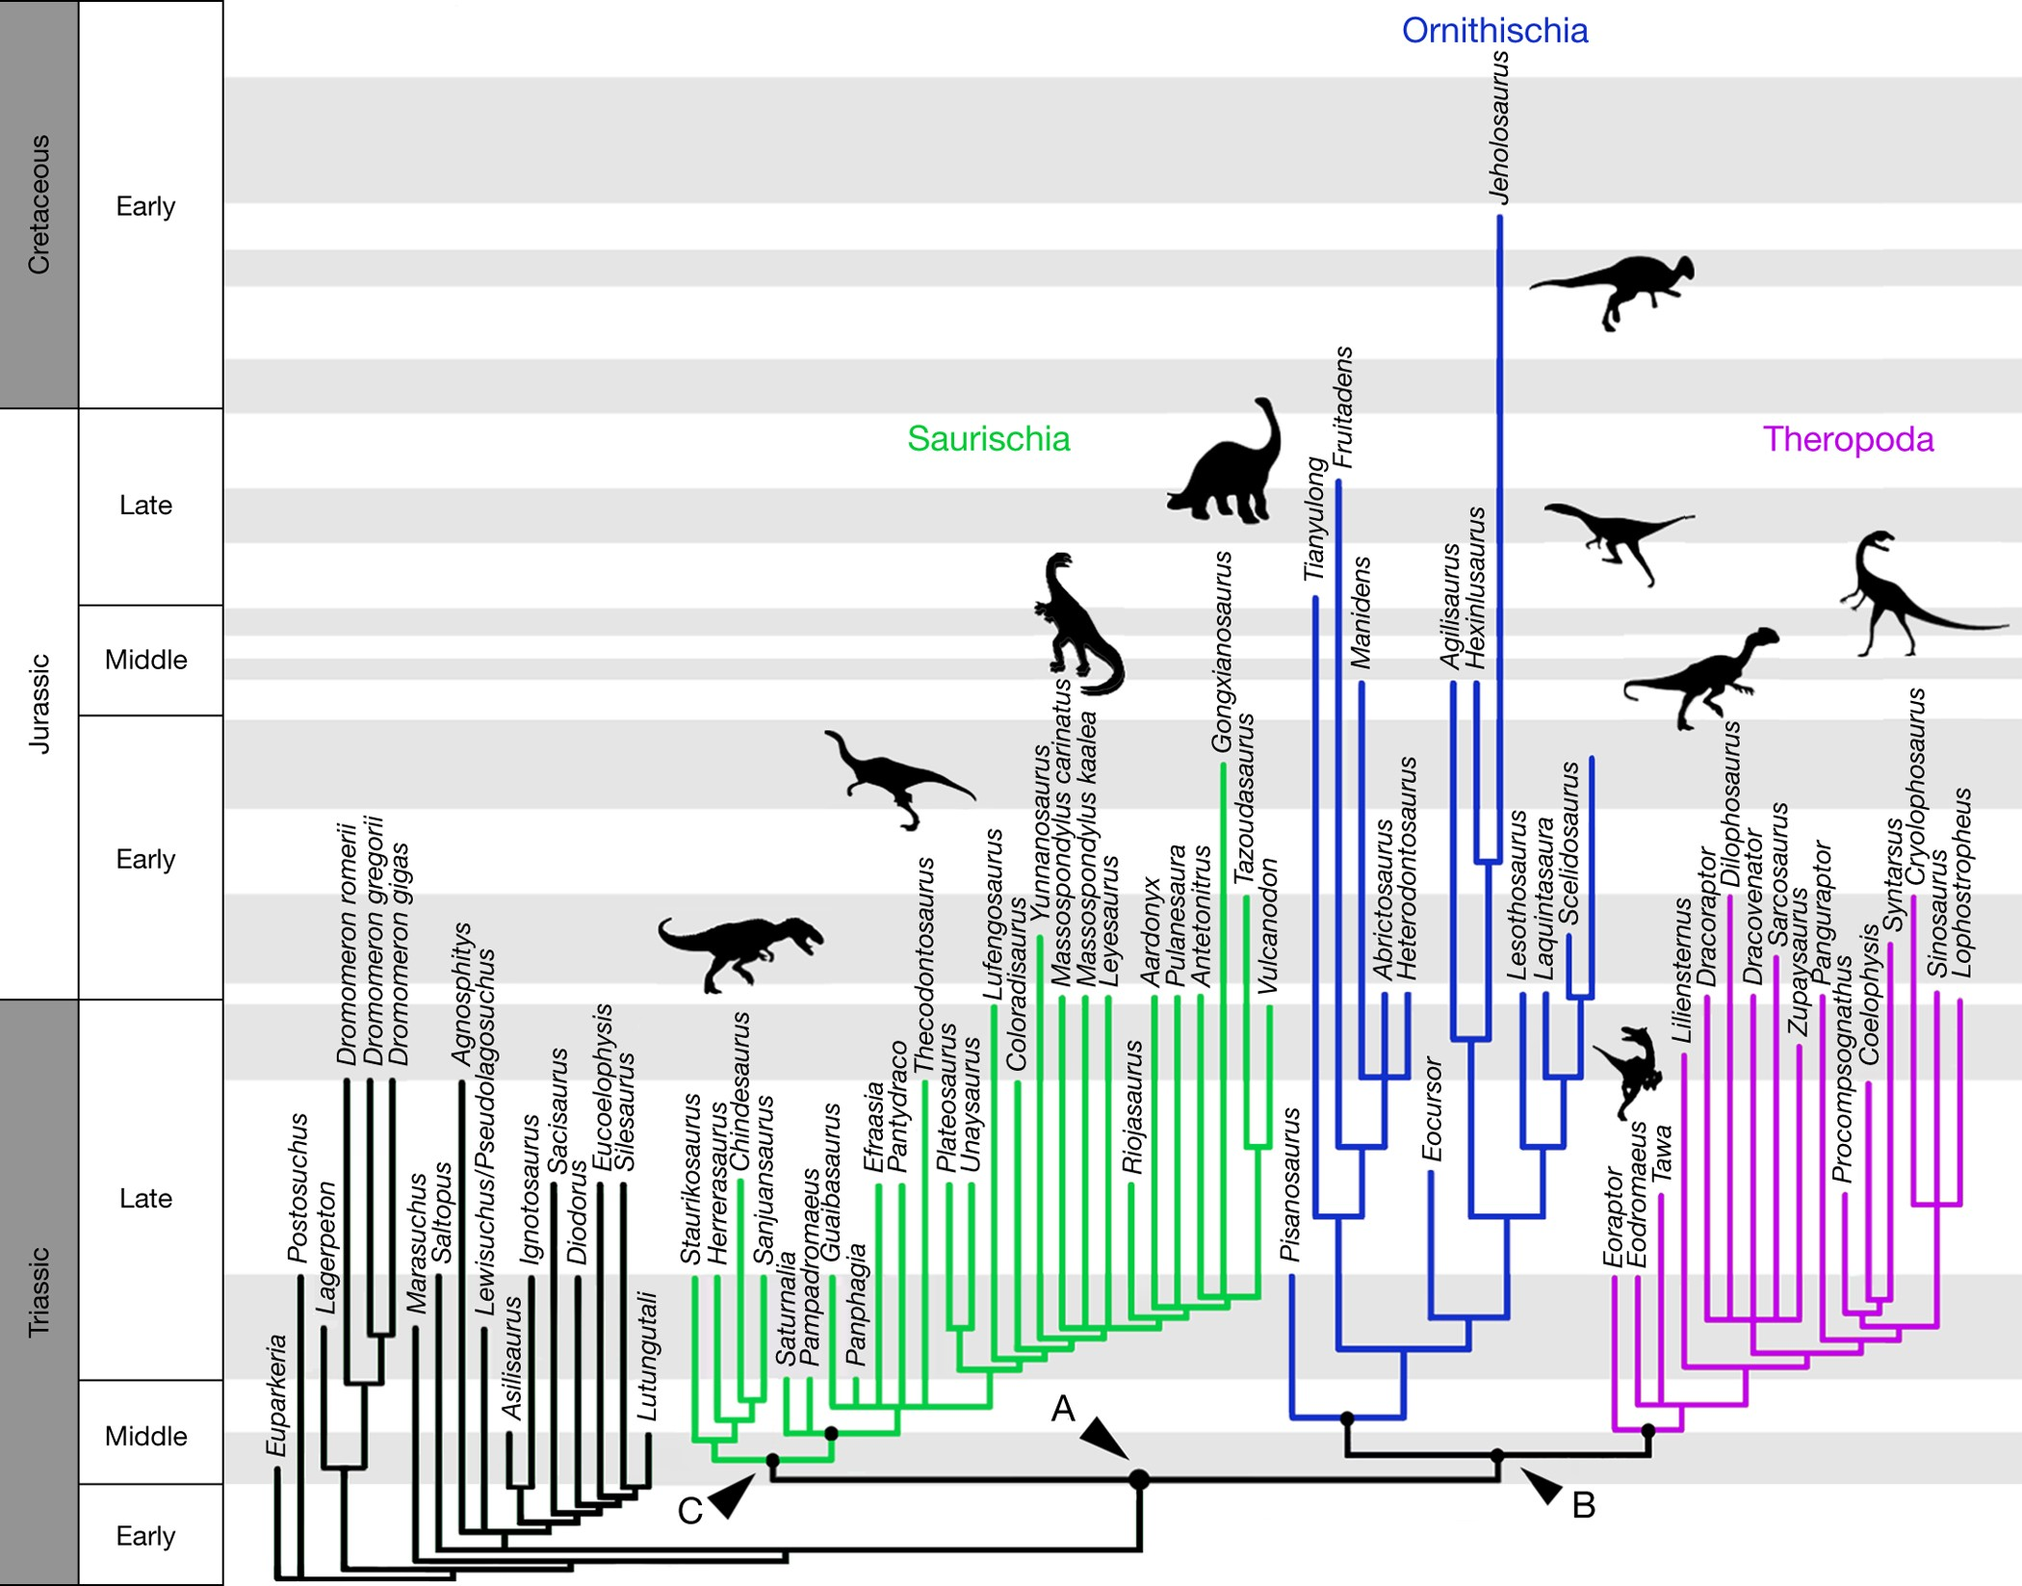

Slide 18
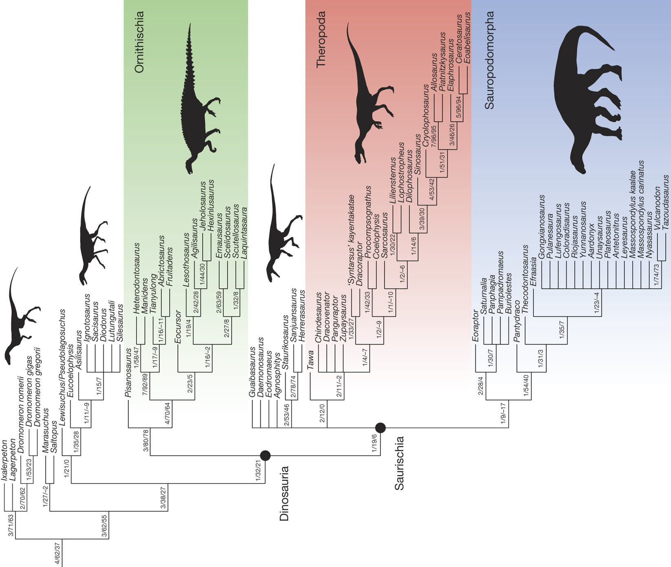

Slide 19
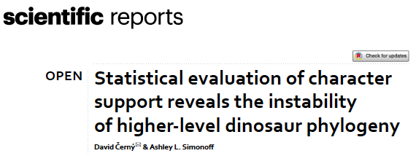
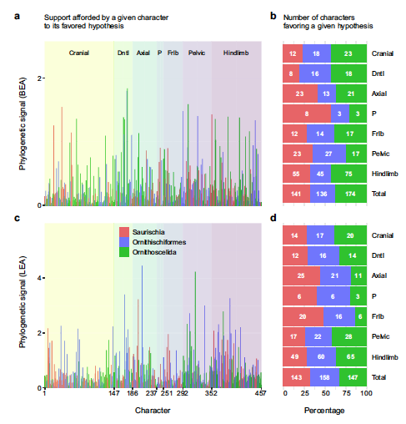
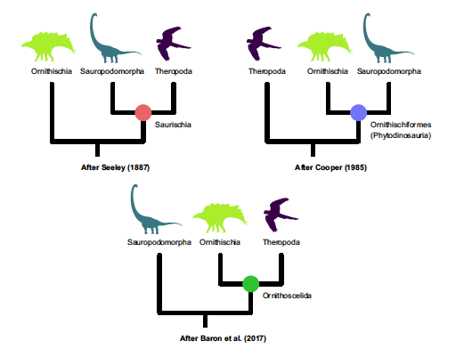

Slide 20
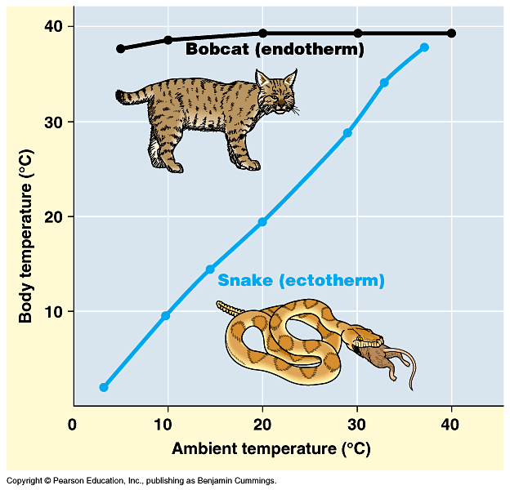
Were nonavian dinosaurs ectotherms or endotherms?

Slide 21
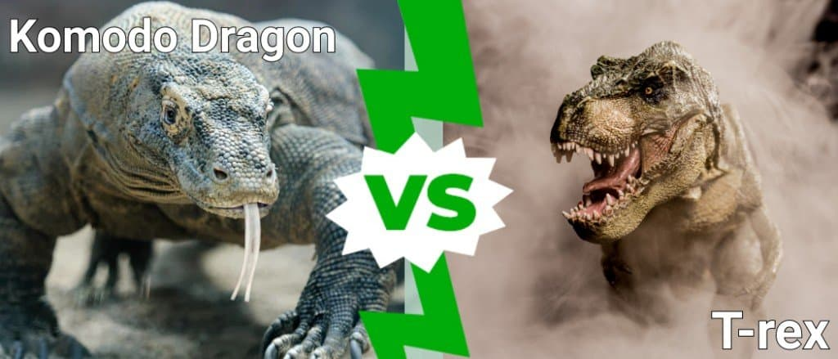
Were nonavian dinosaurs ectotherms?
Given: Ancestors of dinosaurs are ectotherms and nonavian dinosaurs appear lizardlike (they have scales, teeth, etc.), not birdlike.
Hypothesis: Because lizards are ectotherms, nonavian dinosaurs must be ectotherms.

Slide 22
Were nonavian dinosaurs ectotherms?
Given: Ancestors of dinosaurs are ectotherms and nonavian dinosaurs appear lizardlike (they have scales, teeth, etc.), not birdlike.
Hypothesis: Because lizards are ectotherms, nonavian dinosaurs must be ectotherms.
Problem: Nonavian dinosaurs also have many bird characteristics; birds have some typical lizard traits (e.g. scales on feet); hypothesis does not specify any mechanistic link between 'lizardlike' and ectothermy.

Slide 23
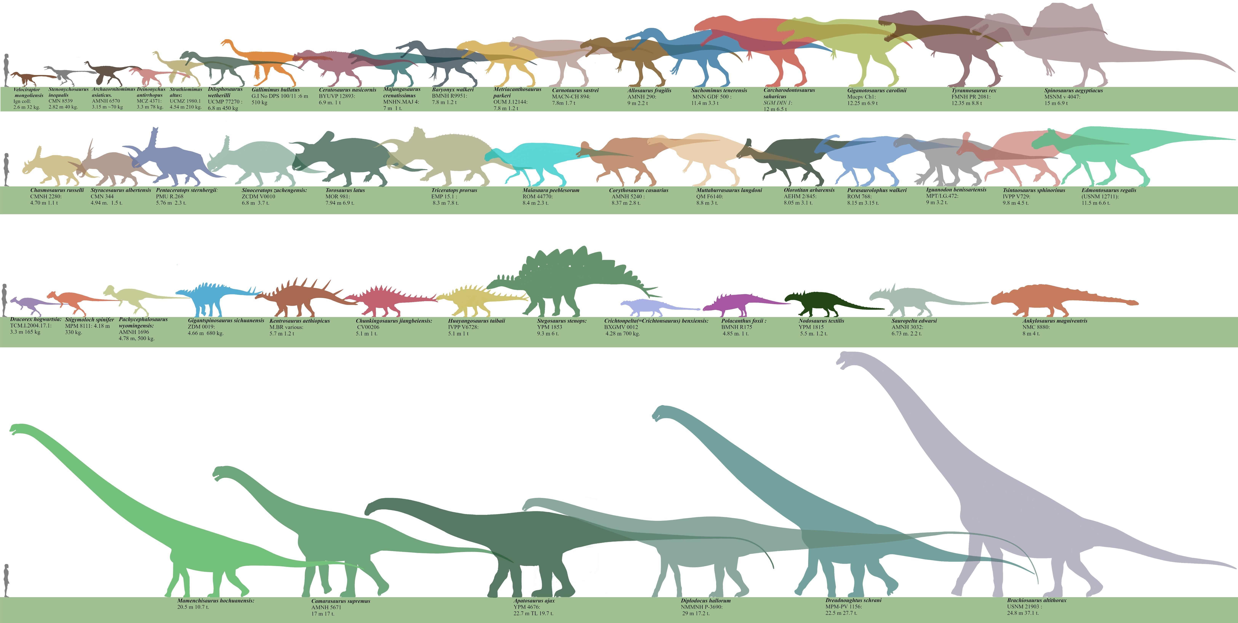
Were nonavian dinosaurs ectotherms?
Given: Dinosaurs were large.
Hypothesis: Dinosaurs did not need to be endotherms; they could be inertial homeotherms.

Slide 24
Were nonavian dinosaurs ectotherms?
Given: Dinosaurs were large.
Hypothesis: Dinosaurs did not need to be endotherms; they could be inertial homeotherms.
.
Problem: Not all adult dinosaurs were large.

Slide 25
Were nonavian dinosaurs ectotherms?
Given: Dinosaurs were large.
Hypothesis: Large endotherms such as mammals and whales have problems with heat; since the Mesozoic was hot, dinosaurs would have cooked if they were endotherms.

Slide 26
Were nonavian dinosaurs ectotherms?
Given: Dinosaurs were large.
Hypothesis: Large endotherms such as mammals and whales have problems with heat; since the Mesozoic was hot, dinosaurs would have cooked if they were endotherms.
Problem: Large extant mammals (whales, elephants) survive using behavioral and other approaches.

Slide 27
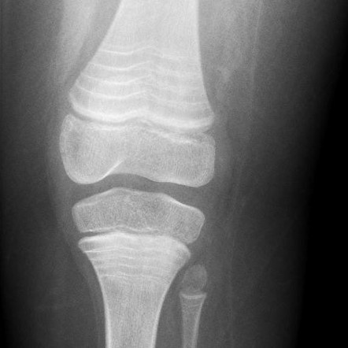
Were nonavian dinosaurs ectotherms?
Given: The bone structure of some dinosaur bones exhibit lines of arrested growth (LAGs), showing that growth was seasonal.
Hypothesis: Because modern endotherms do not have LAGs, and modern ectotherms do, dinosaurs were ectotherms.

Slide 28
Were nonavian dinosaurs ectotherms?
Given: The bone structure of some dinosaur bones exhibit lines of arrested growth (LAGs), showing that growth was seasonal.
Hypothesis: Because modern endotherms do not have LAGs, and modern ectotherms do, dinosaurs were ectotherms.
Problem: Modern endotherms can develop LAGs during periods of stress (malnutrition, etc.). Also, modern ectotherms may lack LAGs.

Slide 29
Were nonavian dinosaurs endotherms?

Slide 30
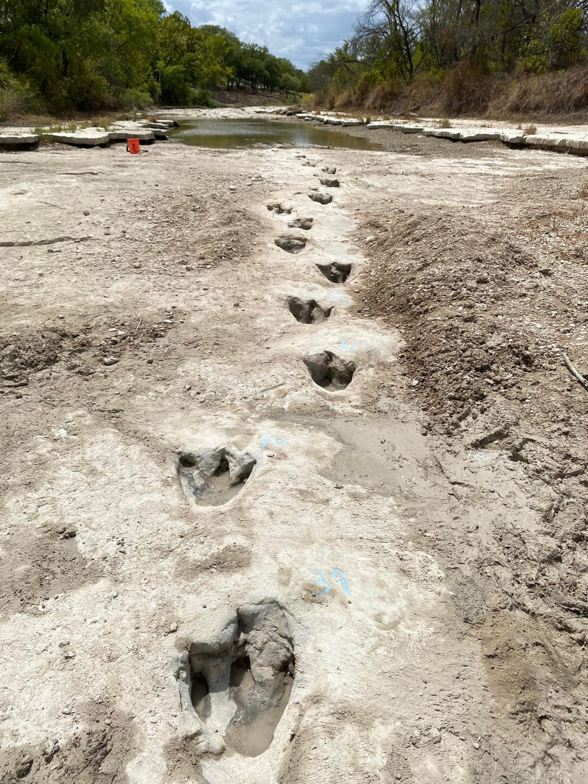
Were nonavian dinosaurs endotherms?
Given: Studies on modern animals seem to show that metabolic rate is proportional to maximum rate of locomotion.
Hypothesis: Dinosaurs apparently were able to move fairly quickly, so they must have had high metabolic rates.

Slide 31
Were nonavian dinosaurs endotherms?
Given: Studies on modern animals seem to show that metabolic rate is proportional to maximum rate of locomotion.
Hypothesis: Dinosaurs apparently were able to move fairly quickly, so they must have had high metabolic rates.
Problem: We do not know how fast dinosaurs really moved.

Slide 32
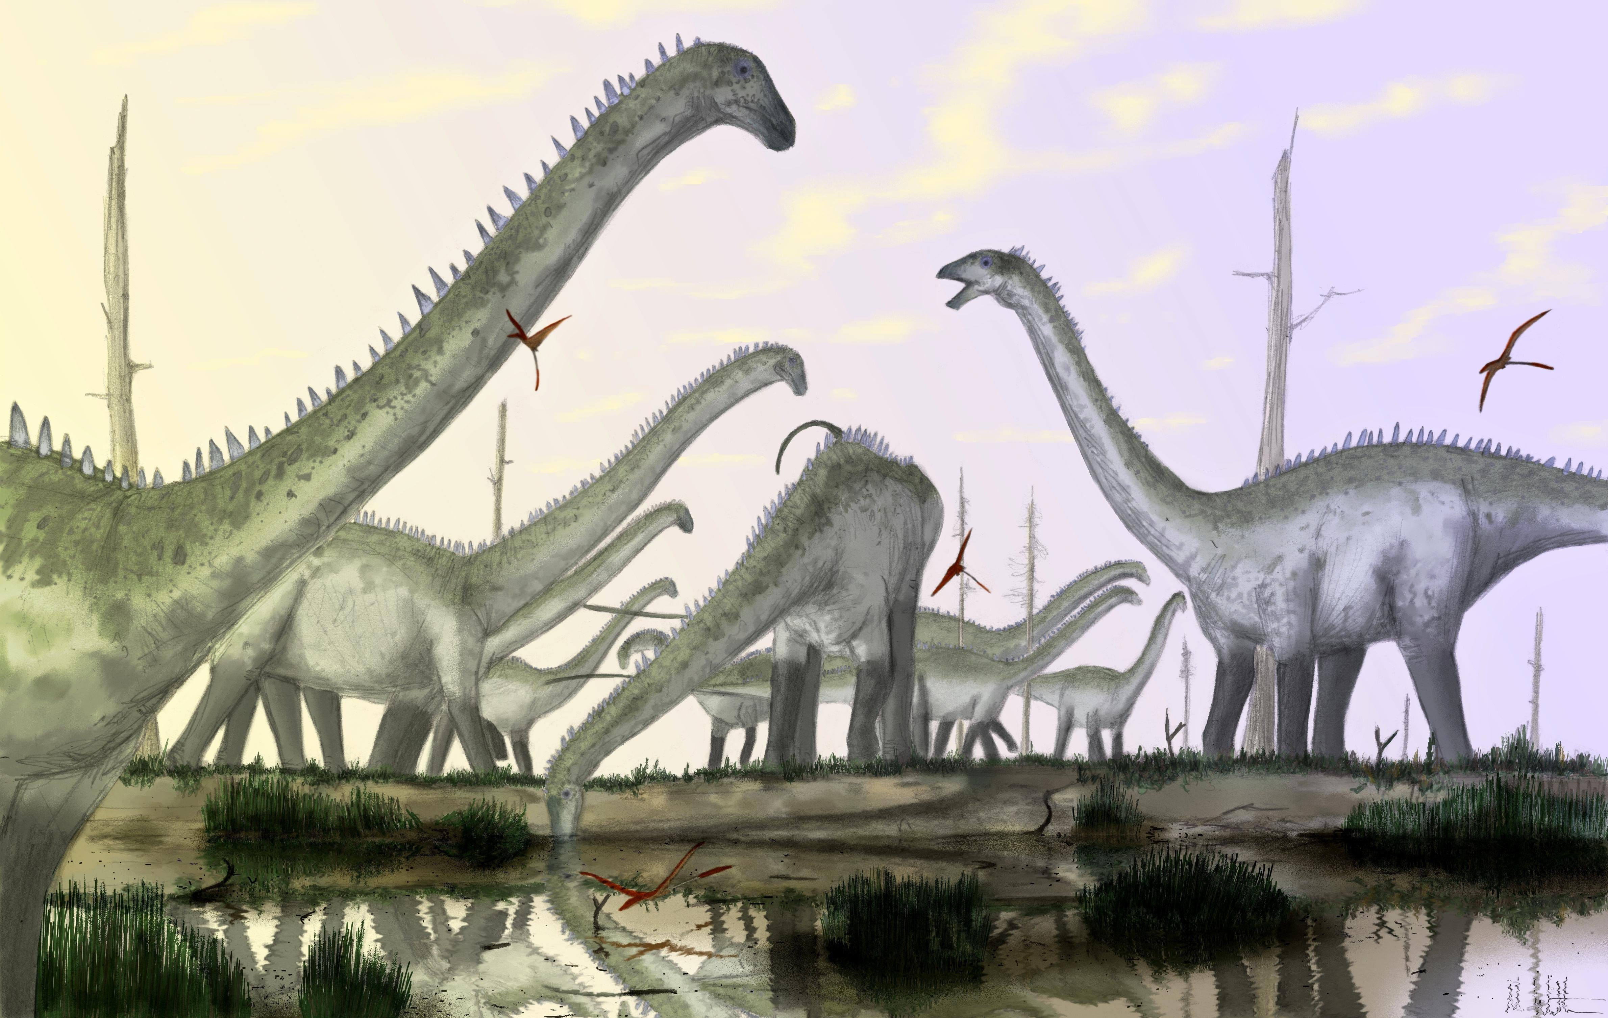
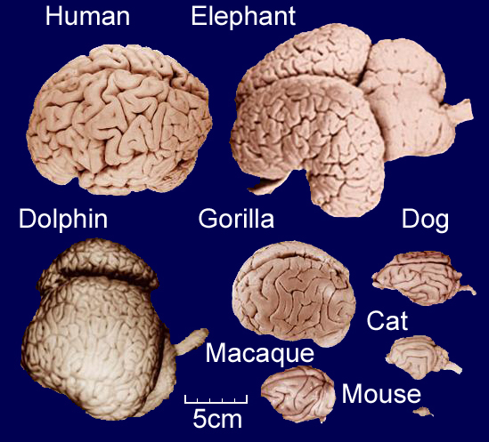
Were nonavian dinosaurs endotherms?
Given: Dinosaurs and modern endotherms both had/have erect posture (weight-bearing limbs oriented directly below the body rather than sprawling out to the sides). Hypothesis: Dinosaurs must have been endotherms; an erect posture must be indicative of endothermy.
Given: Studies indicate that large brain size is correlated with endothermy.
Hypothesis: Theropod and ornithopod dinosaurs had larger than normal brains (for "reptiles"), so they must have been endothermic.

Slide 33
Were nonavian dinosaurs endotherms?
Given: Dinosaurs and modern endotherms both had/have erect posture (weight-bearing limbs oriented directly below the body rather than sprawling out to the sides). Hypothesis: Dinosaurs must have been endotherms; an erect posture must be indicative of endothermy.
Given: Studies indicate that large brain size is correlated with endothermy.
Hypothesis: Theropod and ornithopod dinosaurs had larger than normal brains (for "reptiles"), so they must have been endothermic.
Problem: Correlation is not causation, especially when there are exceptions. Erect posture has not been shown to be necessary for endothermy, or vice versa. Large brain size may be correlated with endothermy, but it is correlated with many other features not necessarily related to endothermy.

Slide 34
Were nonavian dinosaurs endotherms?
Given: Ectotherms are not normally found at high latitudes (it's cold).
Hypothesis: Dinosaur fossils are known from high latitudes, so they must have been endothermic to cope with the cold.

Slide 35
Were nonavian dinosaurs endotherms?
Given: Ectotherms are not normally found at high latitudes (it's cold).
Hypothesis: Dinosaur fossils are known from high latitudes, so they must have been endothermic to cope with the cold.
Problem: The high latitudes (Alaska, Antarctica, etc.) that dinosaur fossils have been found at were not so cold in the Mesozoic; in fact they may have been almost sub-tropical. Even if they were somewhat cold, dinosaurs could have migrated there in the summer when it was warmer, and emigrated during the cooler winter.

Slide 36
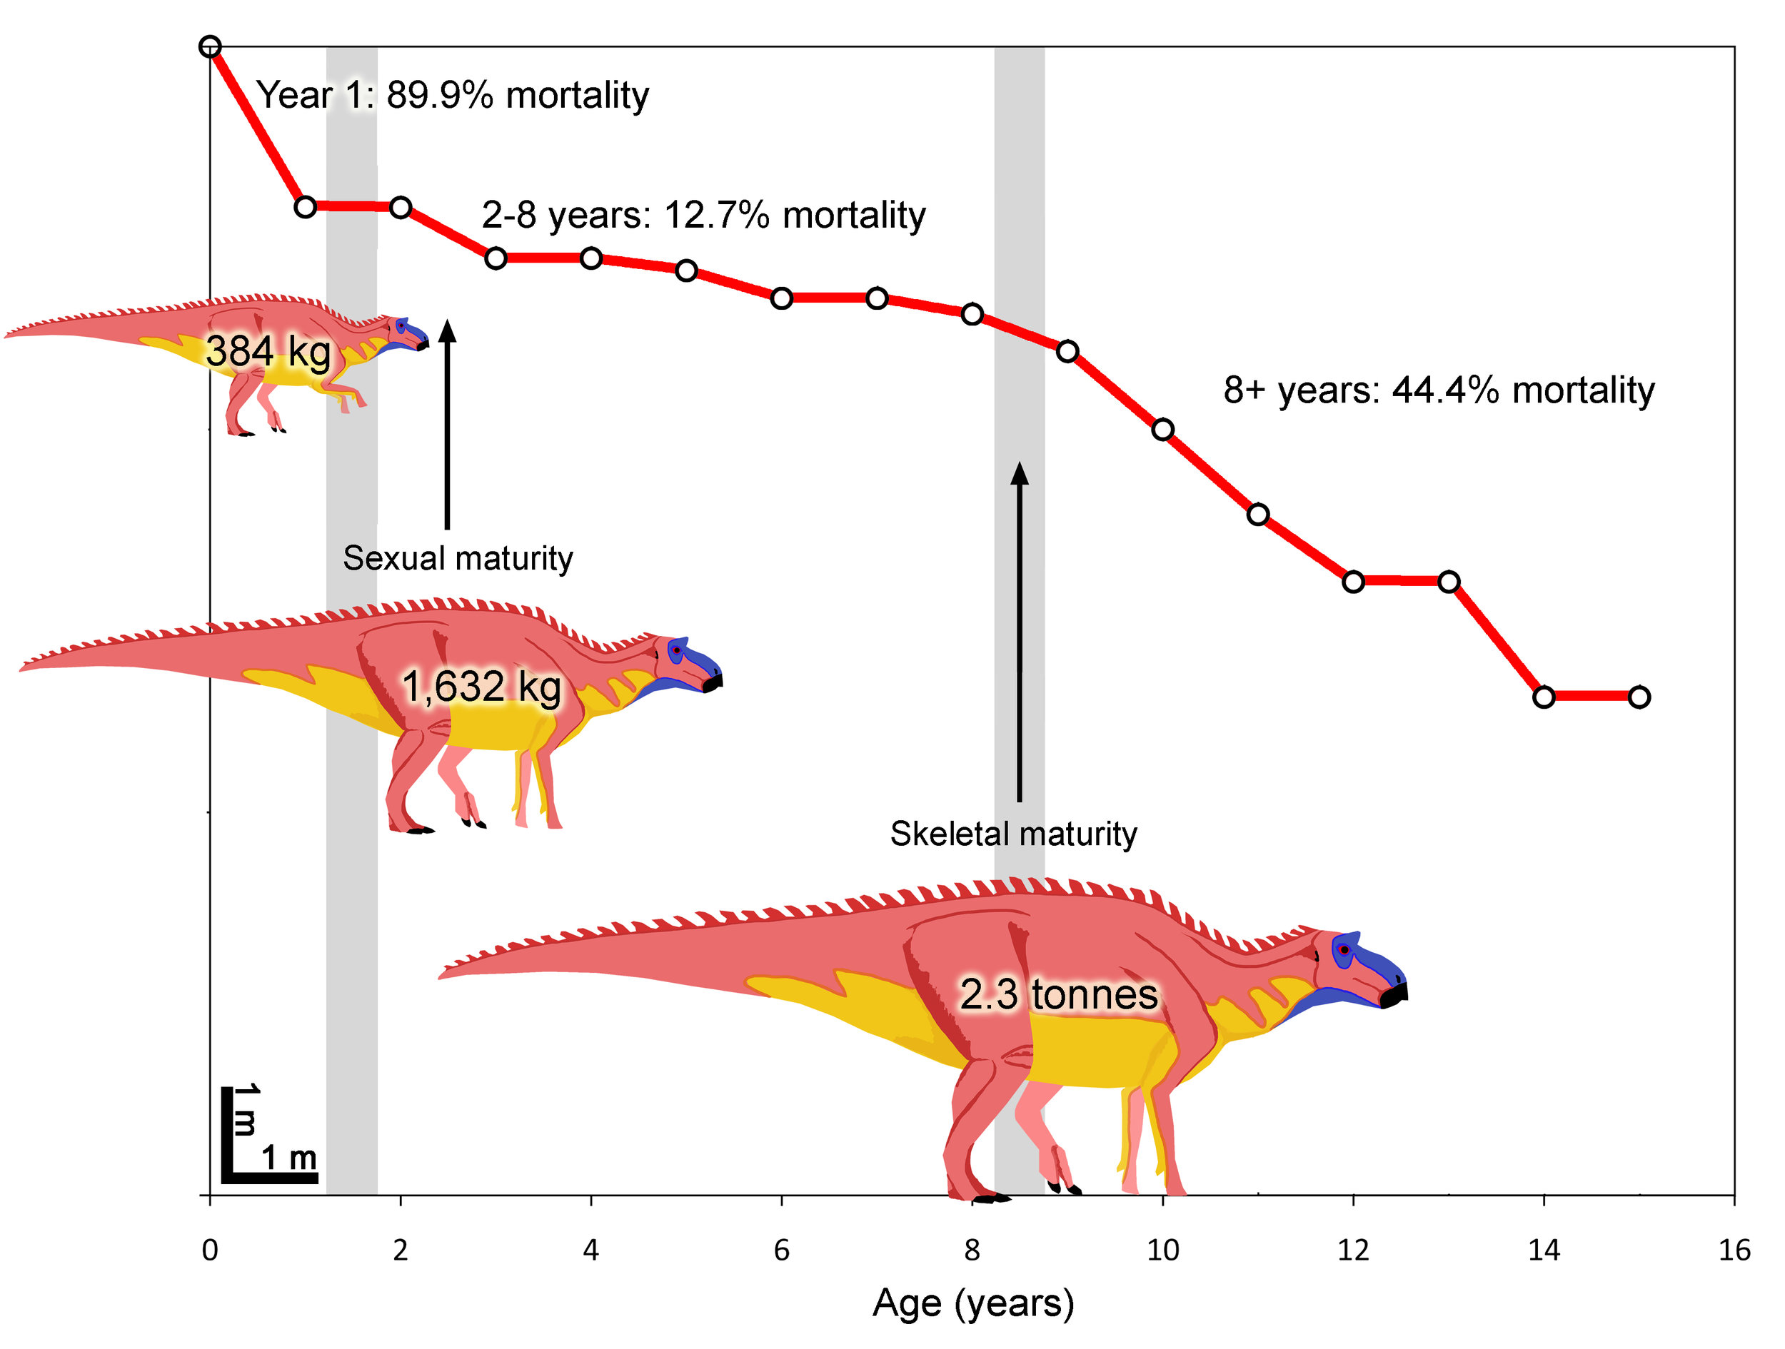
Were nonavian dinosaurs endotherms?
Given: Endothermic animals grow faster than ectotherms.
Hypothesis: Dinosaurs got really big, so they must have been endotherms to reach that size quickly.

Slide 37
Were nonavian dinosaurs endotherms?
Given: Endothermic animals grow faster than ectotherms.
Hypothesis: Dinosaurs got really big, so they must have been endotherms to reach that size quickly.
Problem: If dinosaurs had a long lifespan and were ectothermic, they would have had no problem reaching their huge sizes.

Slide 38
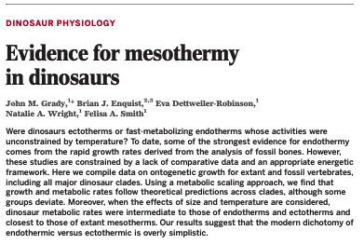
1 Measure (tally) body size and metabolism across ontogeny for extant endothermic and ectothermic species
Map growth—body size--of nonavian dinosaurs onto these data
Assess which ontogeny, ectotherm or endotherm, nonavian dinosaurs match

Slide 39
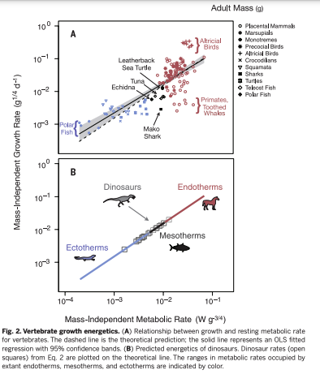

Slide 40
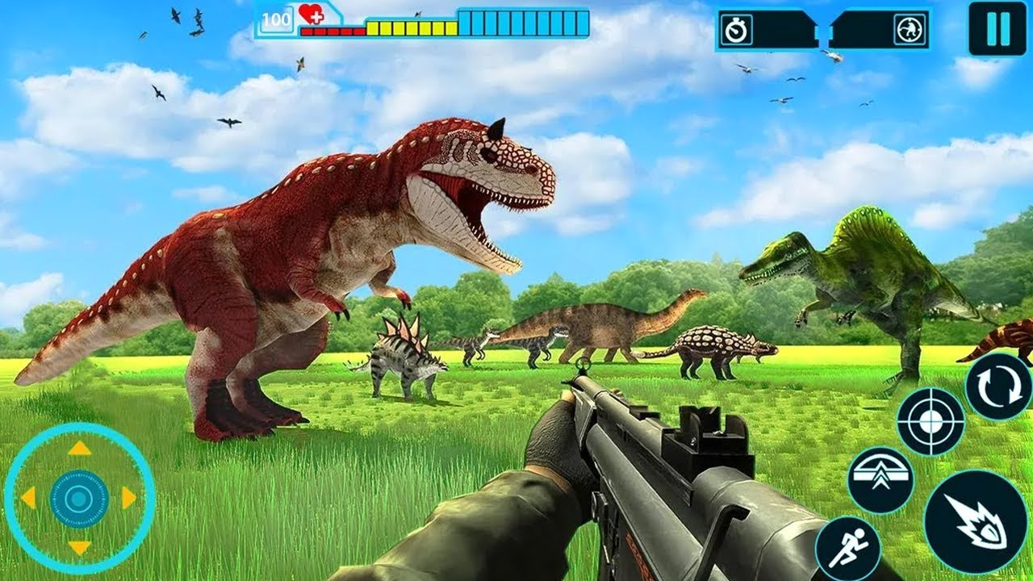
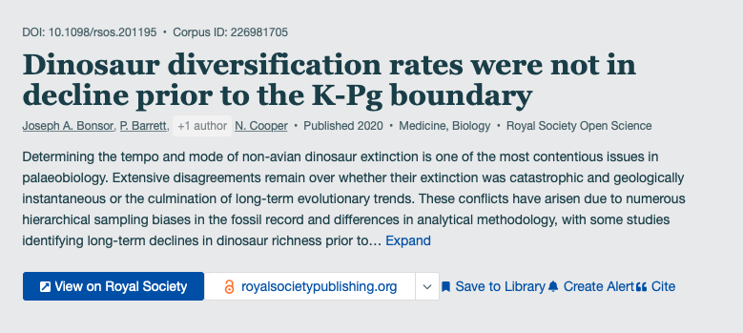
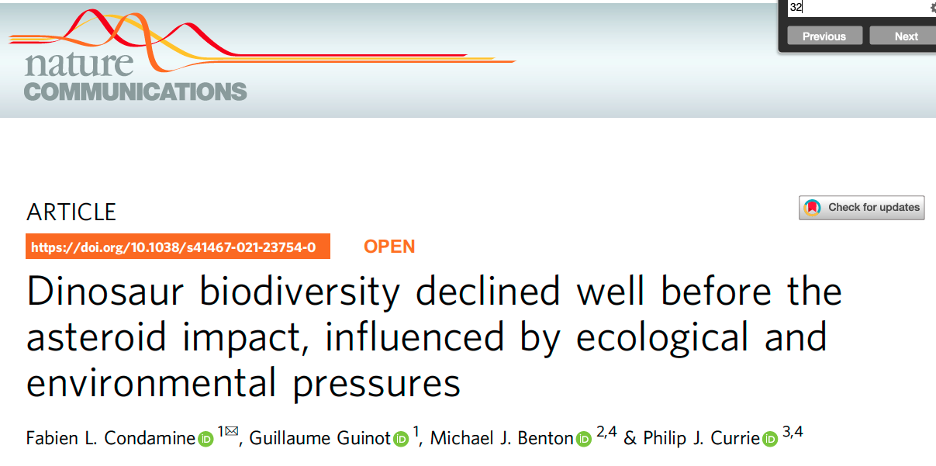
What killed the nonavian dinosaurs?
Volcanic eruptions
Temperature changes
Sea level changes
Asteroid impact
1980 iridium
1991/1978 Chicxulub crater

Slide 41
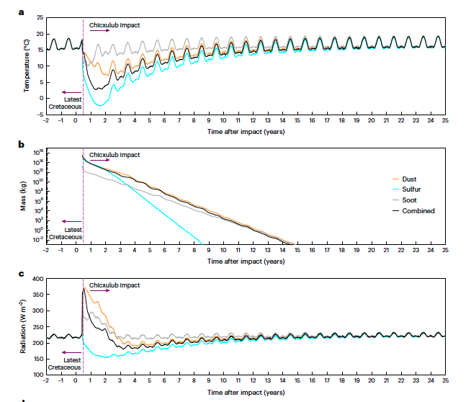
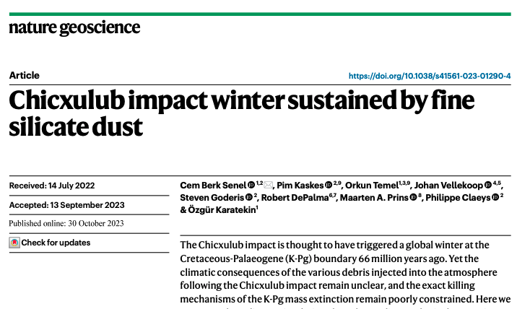
What killed the nonavian dinosaurs?

Slide 43
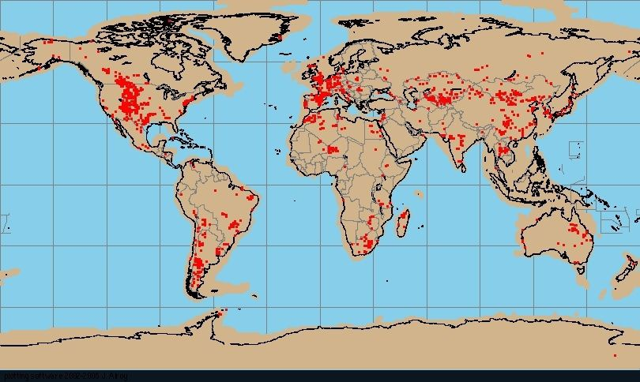
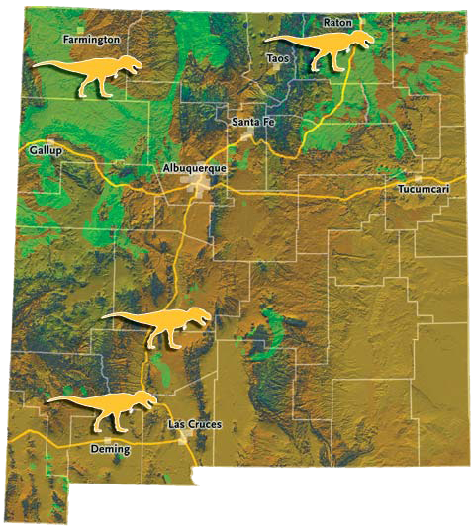
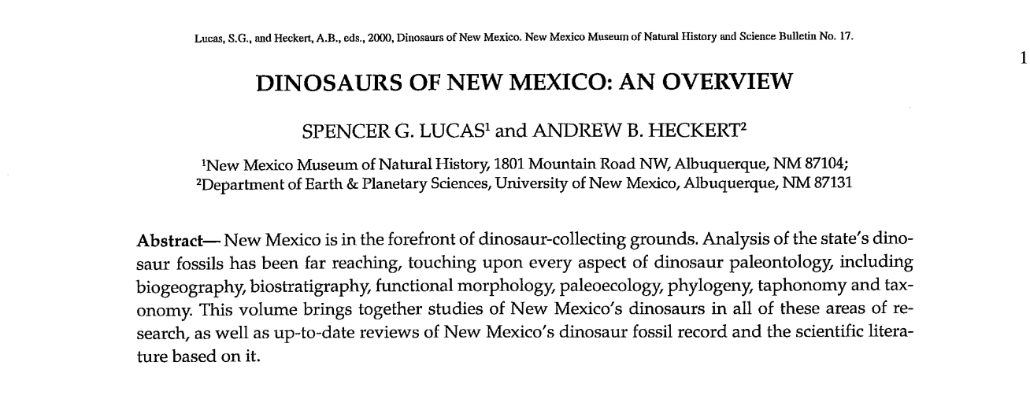

Slide 44
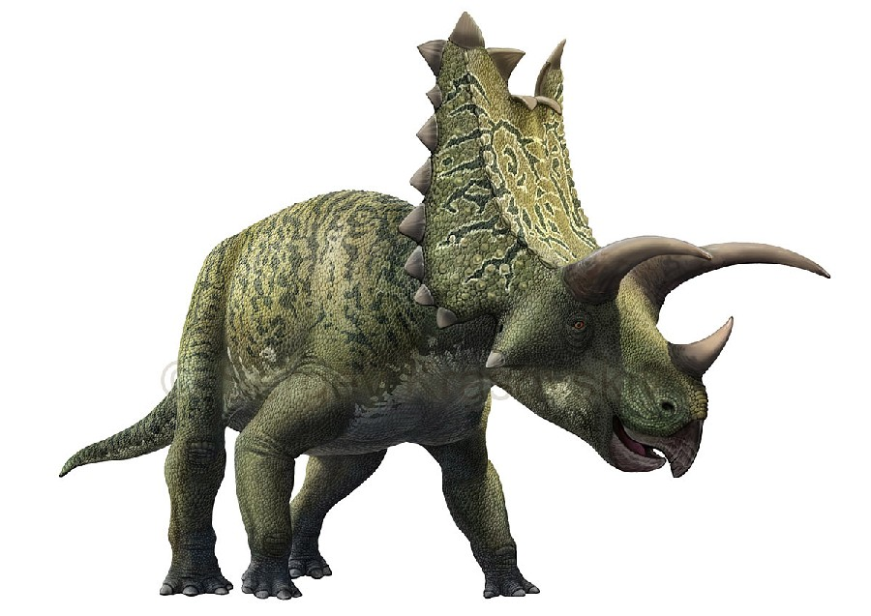
NM dinosaurs: Pentaceratops
H. F. Osborn. 1923. A new genus and species of Ceratopsia from New Mexico, Pentaceratops sternbergii. American Museum Novitates 93:1-3

Slide 45
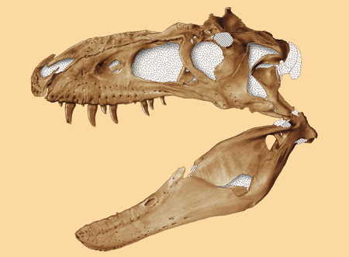
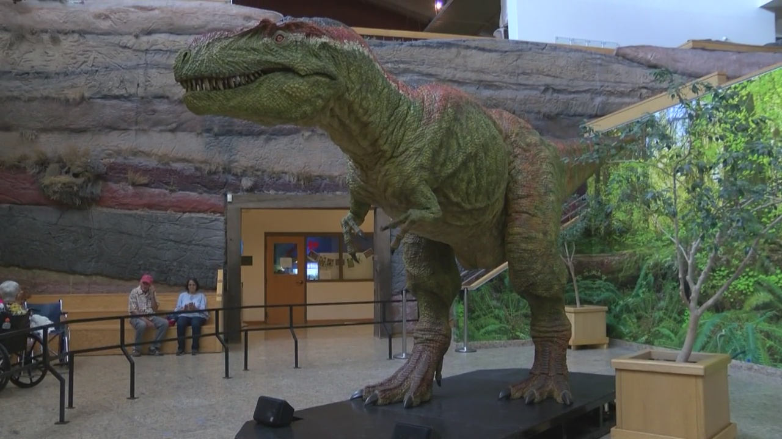
NM dinosaurs:
Bistahieversor sealeyi
The skull of the type specimen of Bistahievorsor sealeyi is currently on display in the Cretaceous Seacoast Exhibit at the Museum of Natural History and Science.

Slide 46
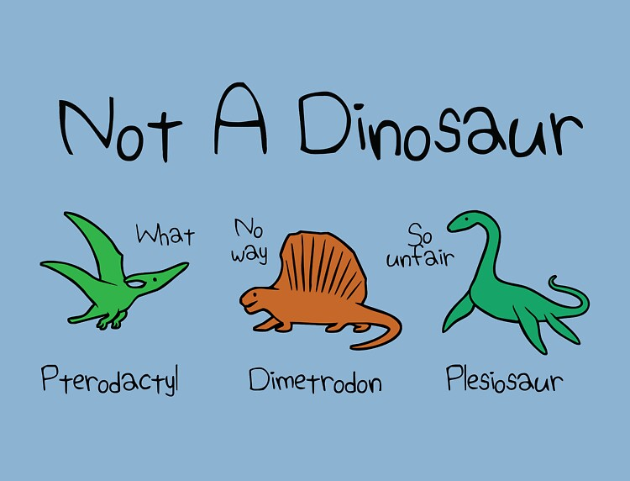
Not a dinosaur

Slide 47
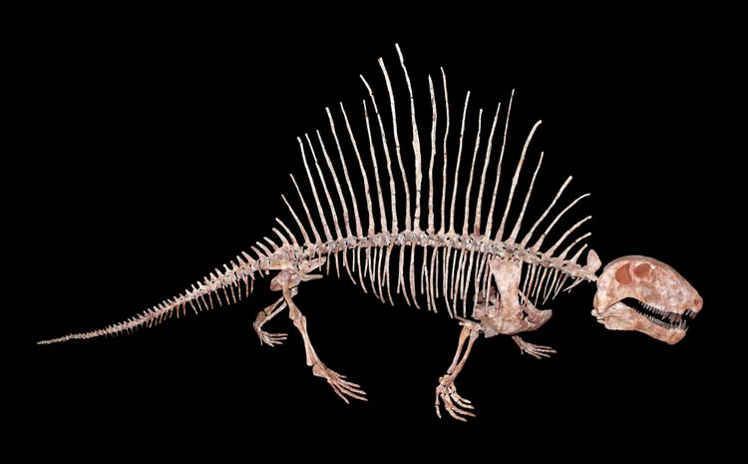
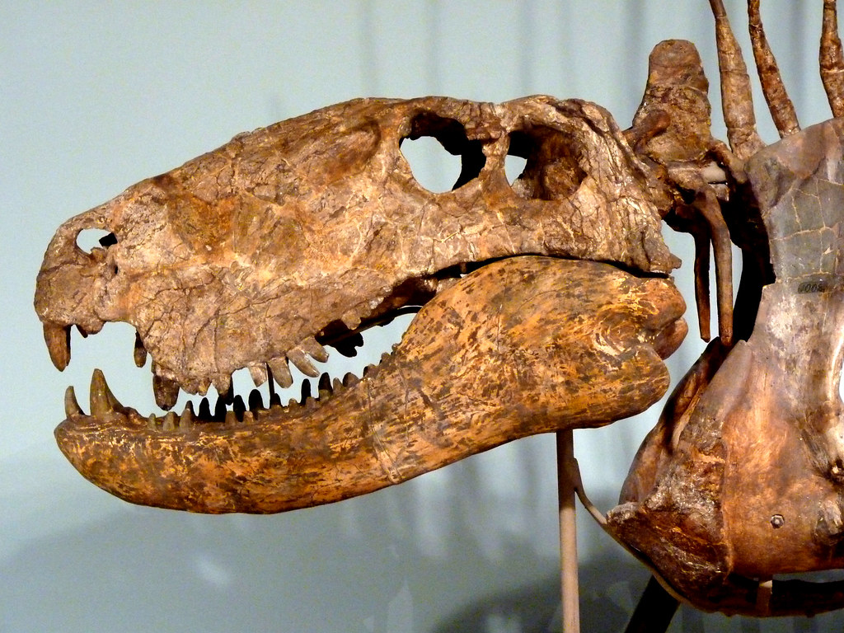
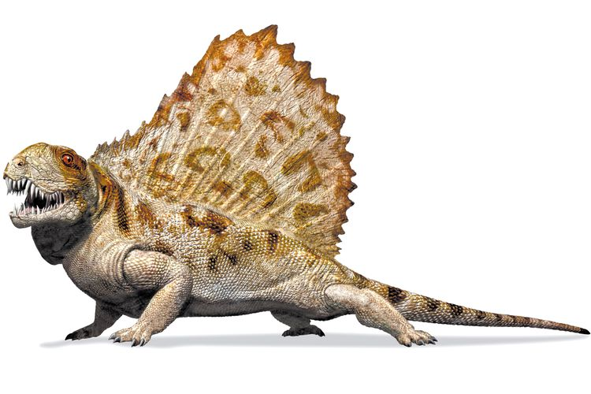
Not a dinosaur: Dimetrodon

Slide 48
Testudines
Aves
Crocodylia
Lepidosauria
Mammalia
Amphibia
Ornithischia
Dimetrodon
Dinosauria
(Ornithischia, Saurischia, Saurischia: Theropoda)
Archosauria
Reptilia
Amniota
Tetrapoda

Slide 49
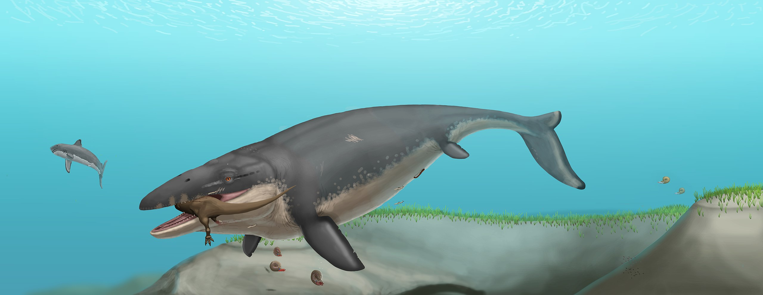
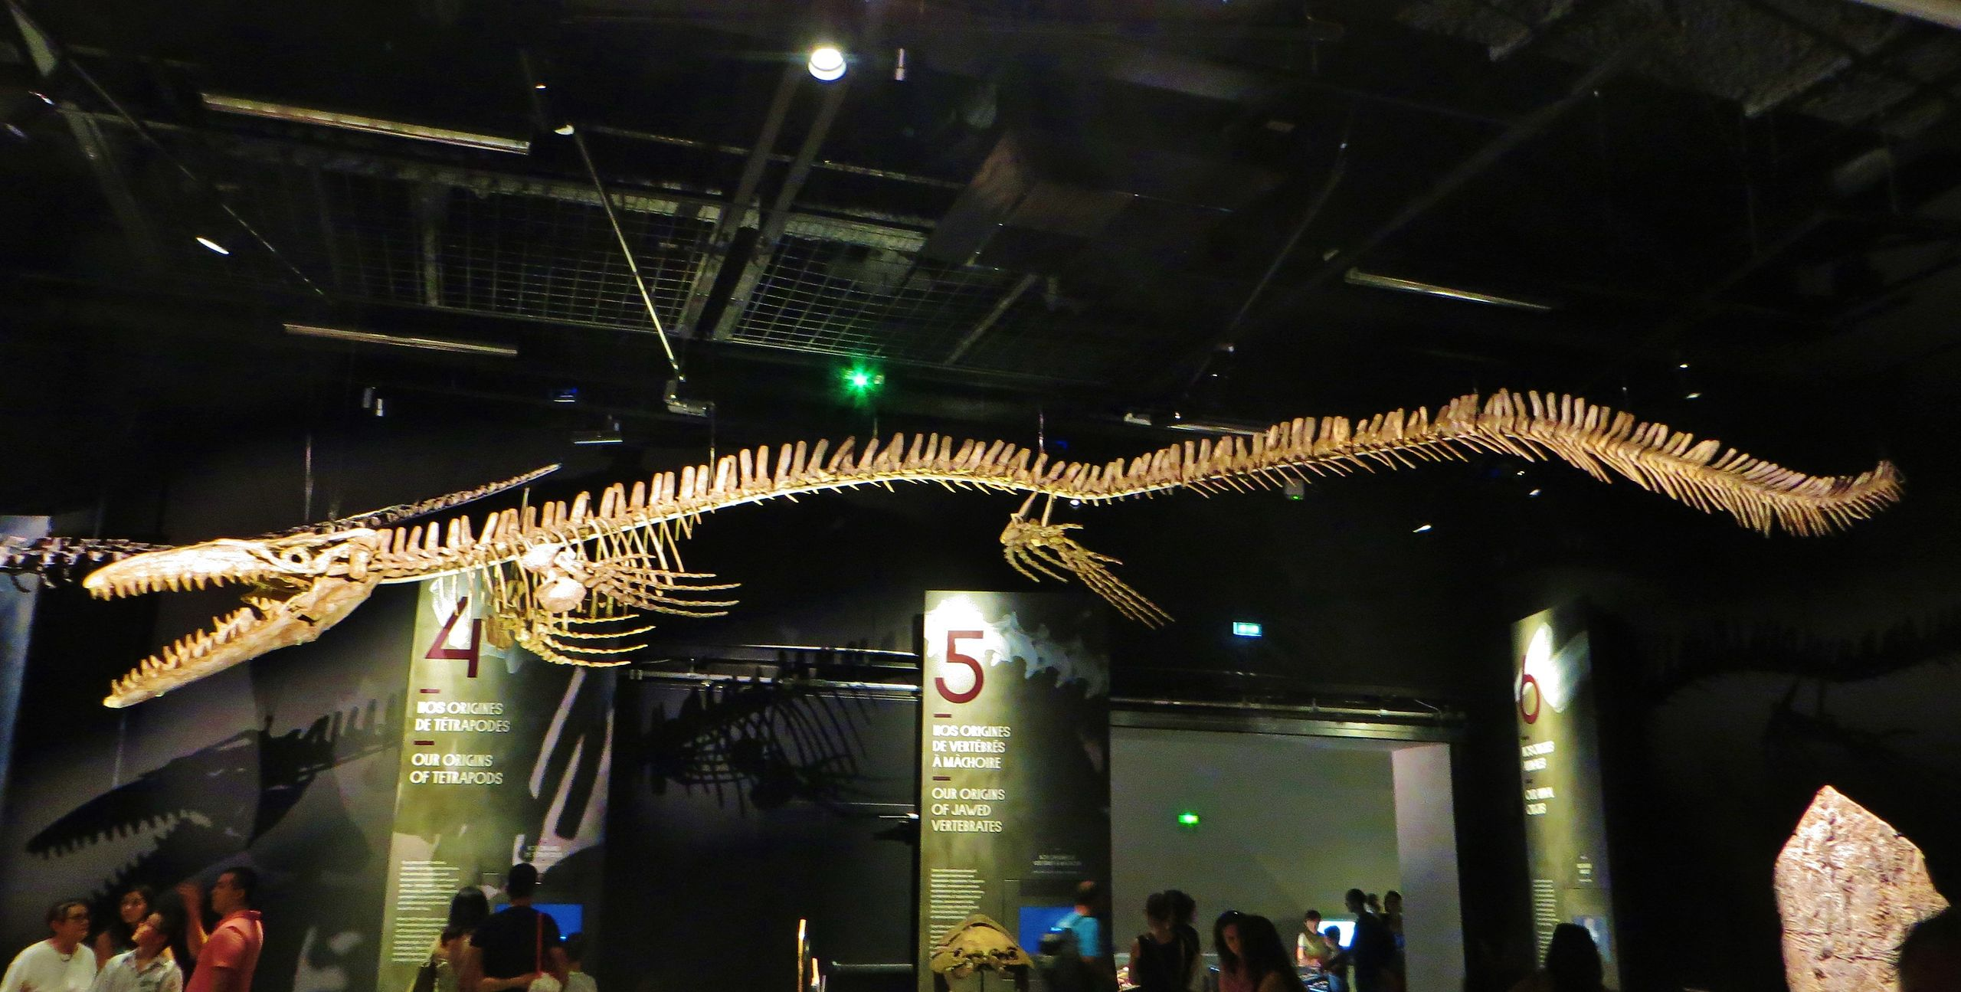
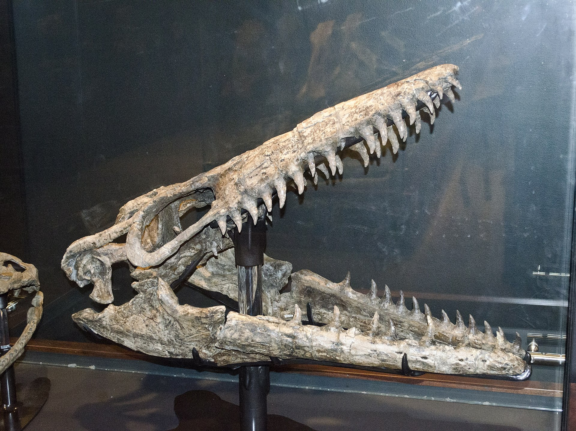
Not a dinosaur: Mosasaurus

Slide 50
Not a dinosaur: Mosasaurus

Slide 51
Testudines
Aves
Crocodylia
Lepidosauria
Mammalia
Amphibia
Mosasaurus
Ornithischia
Dinosauria
(Ornithischia, Saurischia, Saurischia: Theropoda)
Archosauria
Reptilia
Amniota
Tetrapoda

Slide 52
Not a dinosaur: Pterosaurs

Slide 53
Not a dinosaur: Pterosaurs

Slide 54
Testudines
Aves
Crocodylia
Lepidosauria
Mammalia
Amphibia
Ornithischia
Pterosaurs
Dinosauria
(Ornithischia, Saurischia, Saurischia: Theropoda)
Archosauria
Reptilia
Amniota
Tetrapoda

Slide 55
Not a dinosaur: Plesiosaurs

Slide 56
Testudines
Aves
Crocodylia
Lepidosauria
Mammalia
Amphibia
Plesiosaurs
Ornithischia
Dinosauria
(Ornithischia, Saurischia, Saurischia: Theropoda)
Archosauria
Reptilia
Amniota
Tetrapoda

